Slide 1
2023 5th International Conference on Advanced Bioinformatics and Biomedical Engineering (ICABB 2023)
The Study of Non-Invasive Blood Information Measurement and Monitoring Method via Wearable MWPPG Device
Author: Chi Fu Chung, Po Wen Lu, Xiang Jun Zhang, Cheng Chun Chang
Presenter: Chi Fu Chung
Mail: t111318075@ntut.org.tw
Contact: Cheng Chun Chang
Mail: ccchang@ntut.edu.tw
Notes:
Hello everyone, I'm Chi Fu Chung from National Taipei University of Technology. My topic is 'The Study of Non-Invasive Blood Information Measurement and Monitoring Method via Wearable MWPPG Device.

Slide 2
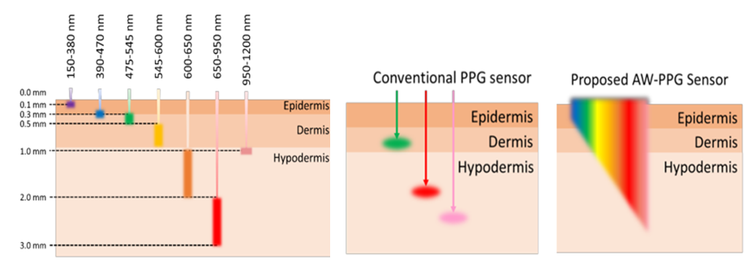
Introduction
In recent years, the prevalence of wearable devices has made smart watches or wristbands capable of detecting physiological information an indispensable accessory in modern life.
Currently, measuring blood physiological values typically requires invasive methods such as pricking, which not only causes discomfort and pain to patients but also increases the risk of infectious diseases and infections.
The MW-PPG sensing technologies utilized in this study can measure using light of different wavelengths. For instance, the infrared wavelength can measure blood oxygen saturation, while the green wavelength can measure heart rate.
Notes:
In recent years, wearable devices like smartwatches and wristbands have become essential in our lives for tracking our health stats. Products like the Apple Watch, Samsung Gear, and Xiaomi Bands offer these functions. Whether it's for fitness, health tracking, convenience, or simply for style, people prefer having a smart wearable. However, current devices mostly focus on heart rate and blood oxygen levels. Some claim to measure blood pressure, but they're often inconvenient and their accuracy is questionable. Moreover, traditional methods for blood-related measurements involve invasive procedures like needles, causing discomfort, infection risks, and pain. So, if we can gather blood-related information non-invasively, it could significantly reduce discomfort and associated risks. That's where my research steps in—developing a non-invasive blood measurement system using AW-PPG and MW-PPG sensor tech. Unlike traditional PPG, AW-PPG uses meaningful wavelengths for various blood elements for AI models, while MW-PPG measures these elements using different light wavelengths for prediction, like infrared for oxygen saturation and green for heart rate.

Slide 3
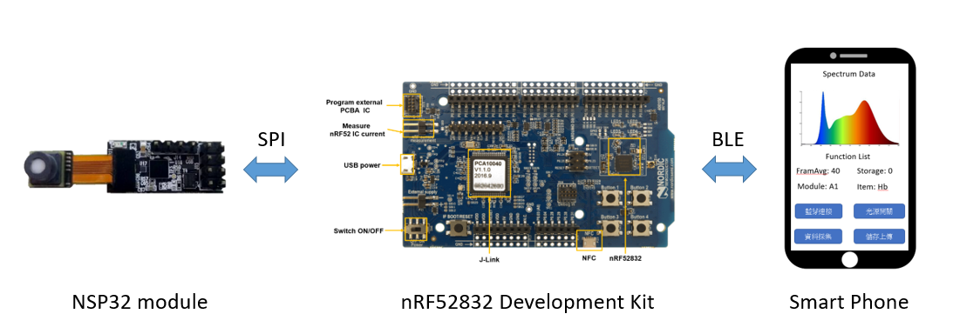
Objective
Developing a full-spectrum optical measurement system combining micro-spectrometer sensors, a smartphone app, 3D printing, microcontrollers, and Bluetooth transmission chips. Utilizing deep neural network technology for spectral signal processing model training to achieve a higher accuracy blood measurement system.

Slide 4
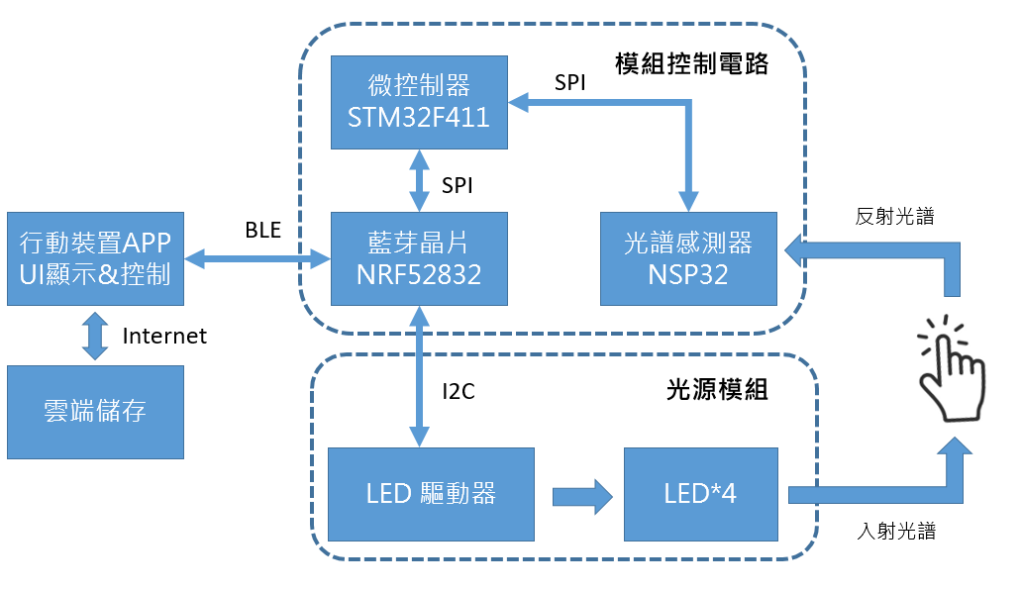
Method
Module Control Circuit
Micro controller STM32F411
Spectrometer NSP32
LED Driver
The measurement device consists of a module control circuit and a light source module. Data collection is handled and displayed through a mobile device app for control purposes.
App UI display & control
Bluetooth module nRF52832
Spectrometer NSP32
Reflection spectrum
Cloud storage
Light Source Module
Spectrometer NSP32
LED Driver
Incident spectrum
LED Driver

Slide 5
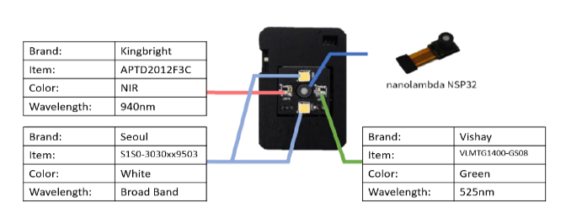
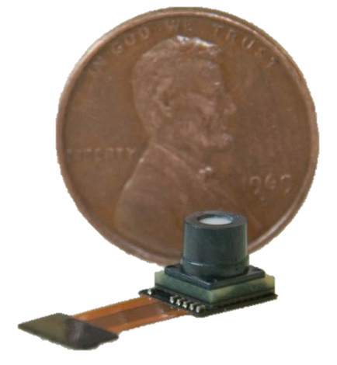
Method
Wearable Spectrometer Measurement Device
nanoλ apolloTM sensor | Wavelength range: | 400 nm~1000 nm
 | Resolution: | 25~30 nm
 | ADC Full Scale: | 0~3.3V
 | A/D resolution: | 12-bits
 | SNR: | > 100:1
 | Dynamic Range: | > 1000:1
 | Integration Time: | 211us~, manual or auto setting
The micro-spectrometer sensor chip utilizes a large array of micro-spectrometer sensors to extract spectral information, offering not only a compact size but also relatively lower costs.

Slide 6
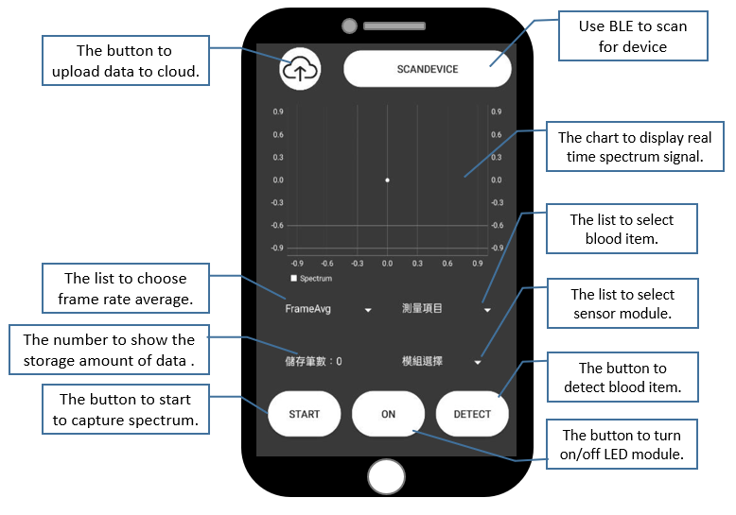
Method
App UI & Guide
To facilitate researchers in collecting spectral signal data in clinical settings, this study developed a measurement App using Android Studio and Java.

Slide 7
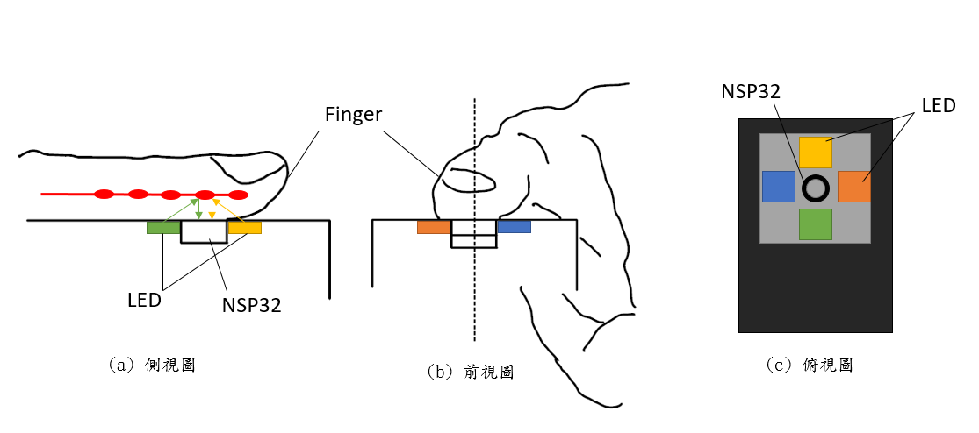
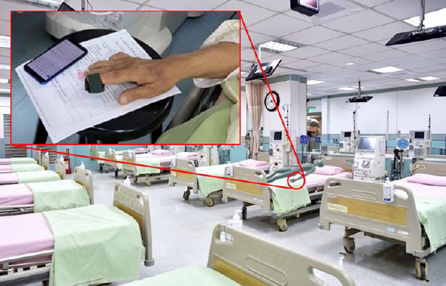
Method
The data collection method for the measurement device
Side view
Front view
Top view
The primary area of measurement is the fingertip. To collect data, subjects place their fingertip onto the spectral sensor located at the center of the device to initiate data collection.

Slide 8
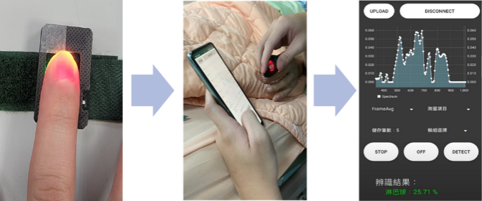
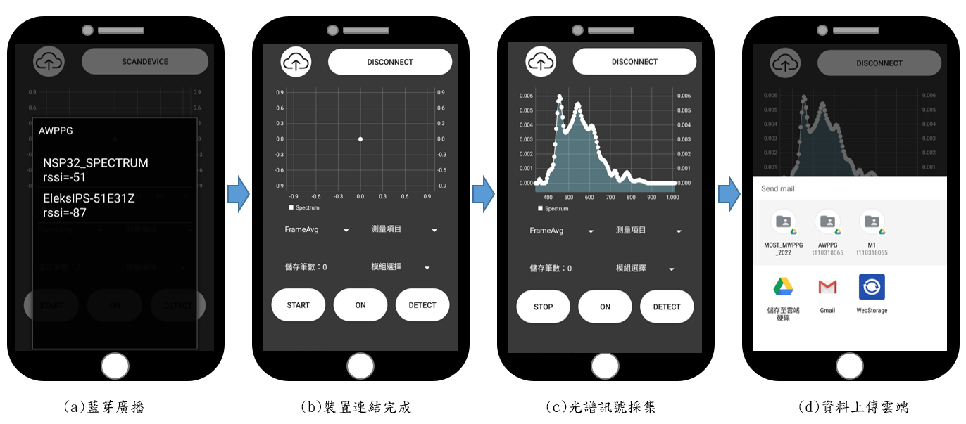
Method
The data collection workflow
After the subjects press the measurement device, the collected data is displayed via the app, then saved and uploaded to the cloud.
Bluetooth broadcasting
Device connected
Spectrum Collecting

Slide 9
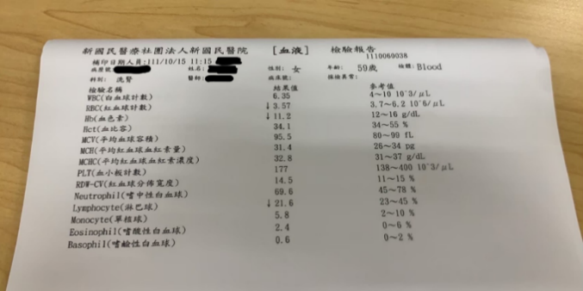
Method
The experimental data was collected from the hospital, including both kidney disease patients preparing for dialysis and patients from the gastroenterology department.
Experimental Data analysis and labeling
The subjects' various parameters are labeled through blood test reports. If the values fall within the reference range, they are labeled as 'normal'; however, if they exceed or fall below the reference range, they are labeled as 'abnormal'.

Slide 10
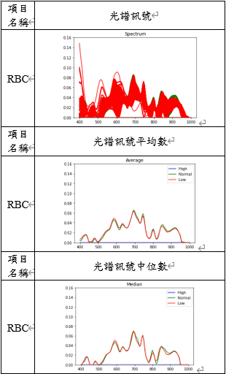
Method
We’re primarily focus on these specific items.
That's due to the variance in data distribution.
RBC Spectrum Analysis
Item
Spectrum
Hgb
AST/GOT
Sodium(Na)
Platelet Count
Total Protein
Calcium(Ca)
Phosphorus(P)
Blood sugar
RBC
Potassium(K)
Item
Average of Spectrum
After analyzing the spectral signals for various blood parameters, a data cleaning process was conducted before proceeding with the training of the DNN model.
Item
Median of Spectrum

Slide 11
Result
The Test Results of DNN Model
Data For Training & Testing
RBC | Test1 | Test2
Accuracy | 80.62% | 57.22%
F1 Score | 81.79% | 71.53%
PLT | Test1 | Test2
Accuracy | 62.88% | 30.05%
F1 Score | 59.20% | 30.28%
Item | Training dataset | Test dataset 1 | Test dataset 2
RBC | 304 | 609 | 1211
AC | 76 | 609 | 1211
GOT | 278 | 609 | 1211
Na | 202 | 609 | 1211
PLT | 274 | 609 | 1211
Pro | 154 | 609 | 1211
Ca | 252 | 609 | 1211
P | 252 | 609 | 1211
AC | Test1 | Test2
Accuracy | 82.92% | 64.24%
F1 Score | 49.01% | 26.48%
Pro | Test1 | Test2
Accuracy | 36.12% | 41.12%
F1 Score | 34.84% | 23.25%
GOT | Test1 | Test2
Accuracy | 73.56% | 68.53%
F1 Score | 77.91% | 79.76%
Ca | Test1 | Test2
Accuracy | 64.69% | 53.17%
F1 Score | 66.97% | 66.10%
Na | Test1 | Test2
Accuracy | 70.60% | 74.81%
F1 Score | 75.44% | 83.26%
P | Test1 | Test2
Accuracy | 78.48% | 54.33%
F1 Score | 77.29% | 65.50%

Slide 12
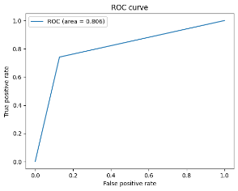
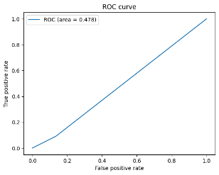
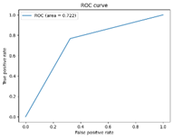
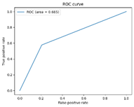
Result
The ROC Curves for RBC and Na Testing
RBC
Test dataset 1 | Test dataset 2
Na
Test dataset 1 | Test dataset 2
The ROC curve of the model, using RBC and Na as examples in the test.

Slide 13
Conclusion & Future
In the future, we will continue researching in the following major directions,
Observing how signal waveforms measured at different times vary due to various experimental factors and enhancing the model's generalization.
Whether different demographics exhibit varied accuracy rates, such as gender, age, or other inherent physiological factors, or designing adaptive models tailored to different individuals to establish personalized models for each person, aiming to explore potential accuracy improvements.
Continuing data collection, expanding the range of blood measurement parameters, and establishing a more comprehensive database.
Optimizing the trained model for lightweight operation and designing the App into a user-friendly version for the public, embedding it into smartphones or MCUs for edge computing. This will make predictions more accessible and convenient for users in the future.
While some models for certain blood parameters have achieved accuracy rates of 70% to 80%, there‘s still room for improvement. There's a need for adjustments and enhancements in data collection, analysis, deep learning algorithms, and model architecture.
Notes:
因此在數據收集與分析、深度學習演算法以及模型架構方面仍有需要調整與加強。

Slide 14
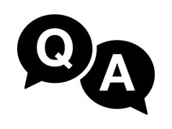
Thank You
Presenter: Chi Fu Chung
Mail: t111318075@ntut.org.tw
Contact: Cheng Chun Chang
Mail: ccchang@ntut.edu.tw

