Slide 1
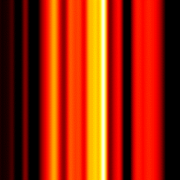
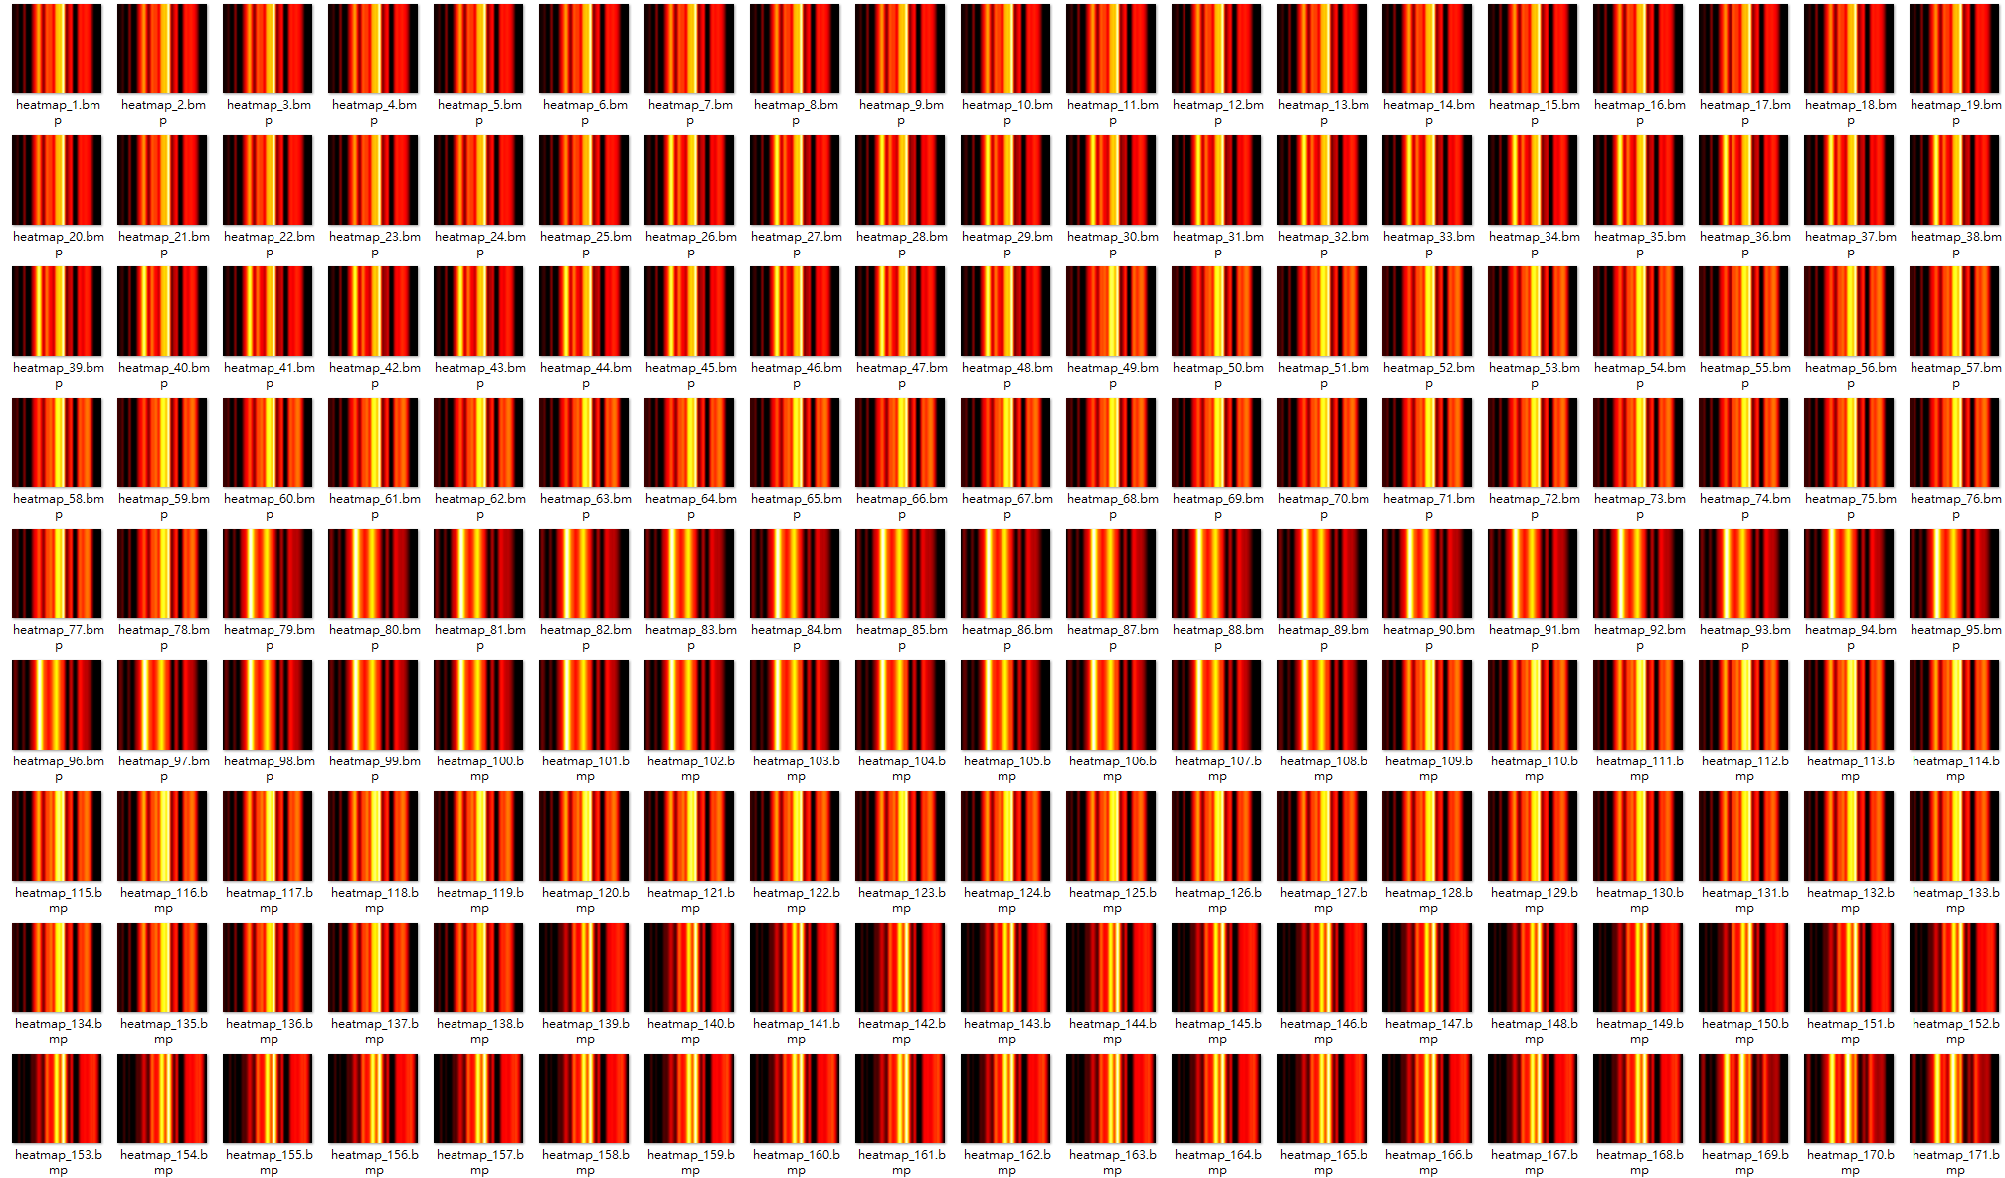
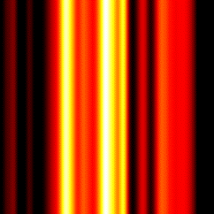
單筆光譜(1x121)
受試者A
受試者B

Slide 2
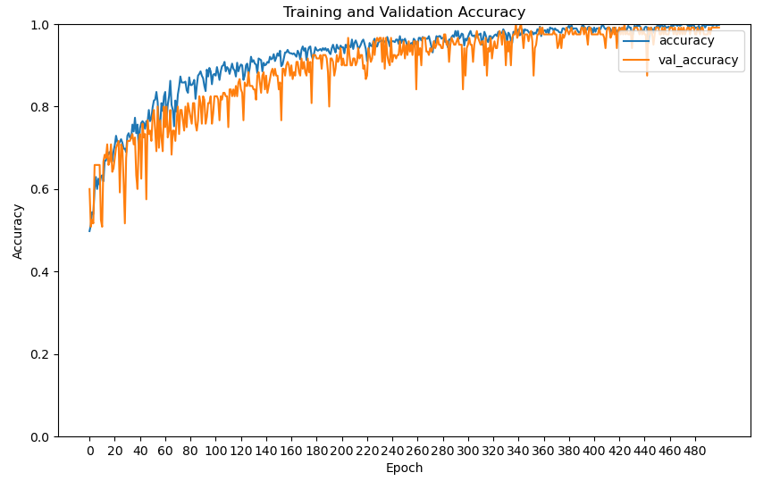
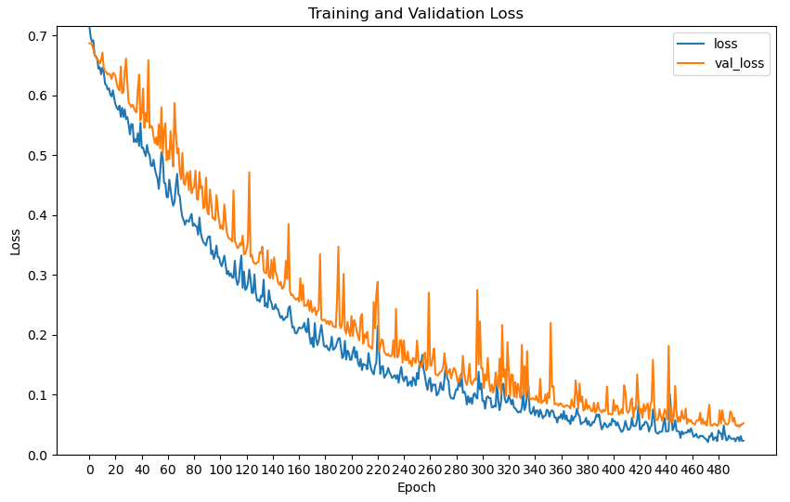
VGG16-AC(500epochs)
異常數: 300
正常數: 300
Heatmap光譜1x121(女性)
驗證集表現:
Learning rate = 0.001
F1-Score: 0.9915
Recall: 0.9831

Slide 3
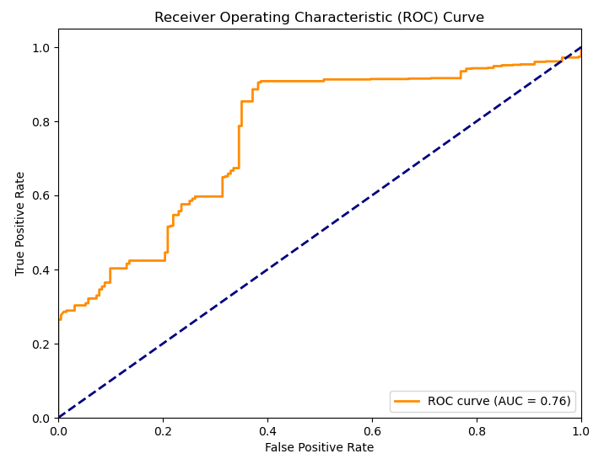
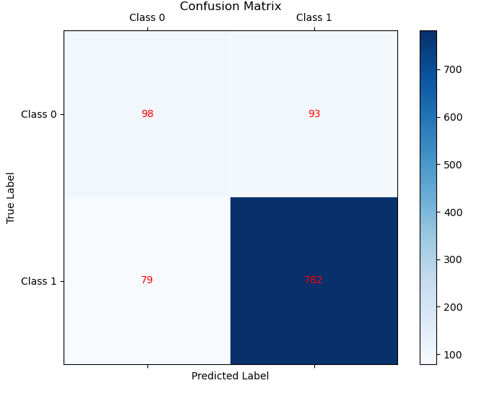
VGG16-AC(500epochs)
Heatmap光譜1x121(女性)
測試集表現:
F1-Score: 0.9009
Recall: 0.9082
precision recall f1-score support
Class 0 0.55 0.51 0.53 191
Class 1 0.89 0.91 0.90 861
accuracy 0.84 1052
macro avg 0.72 0.71 0.72 1052
weighted avg 0.83 0.84 0.83 1052

Slide 4
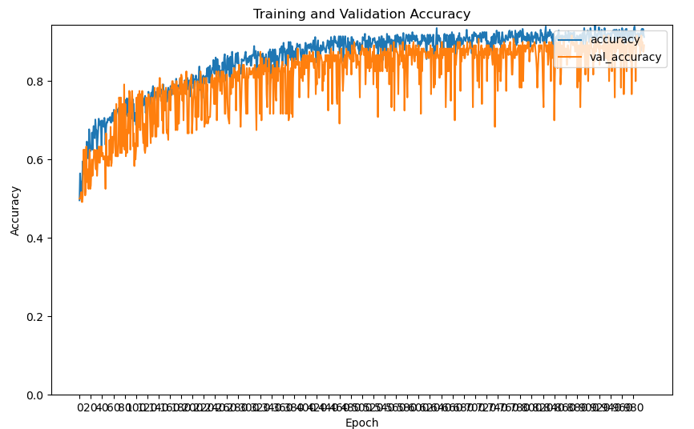
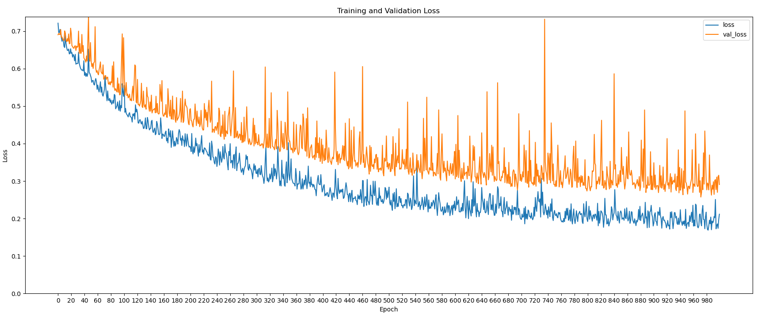
VGG16-AC(1000epochs)
異常數: 300
正常數: 300
Heatmap光譜1x121(女性)
驗證集表現:
Learning rate = 0.001
F1-Score: 0.8870
Recall: 0.8644

Slide 5
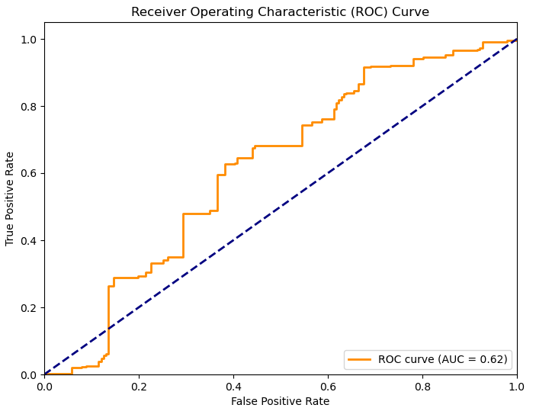
VGG16-AC(1000epochs)
Heatmap光譜1x121(女性)
測試集表現:
F1-Score: 0.7336
Recall: 0.6318
precision recall f1-score support
Class 0 0.26 0.59 0.36 191
Class 1 0.87 0.63 0.73 861
accuracy 0.62 1052
macro avg 0.57 0.61 0.55 1052
weighted avg 0.76 0.62 0.67 1052

Slide 6
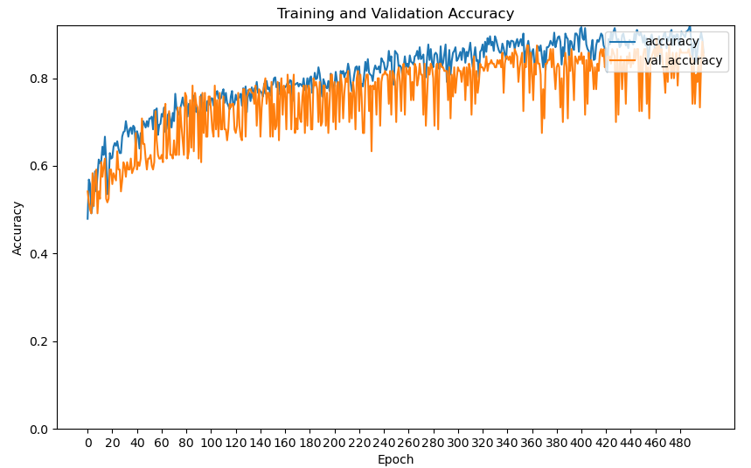
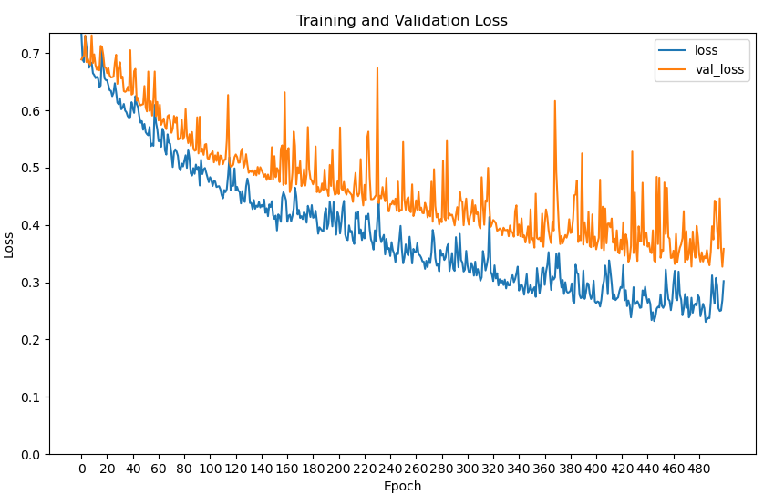
VGG16-AC(500epochs)
異常數: 300
正常數: 300
Heatmap光譜1x121(女性)
驗證集表現:
Learning rate = 0.002
F1-Score: 0.8333
Recall: 0.7627

Slide 7
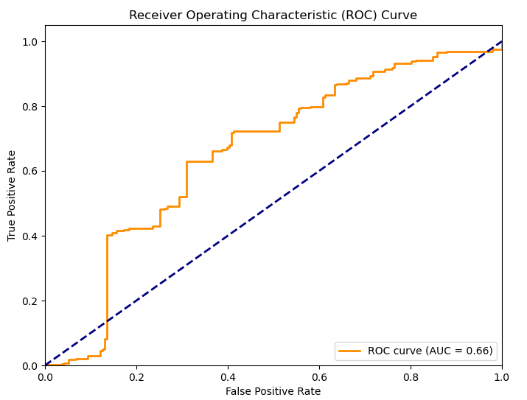
VGG16-AC(500epochs)
Heatmap光譜1x121(女性)
測試集表現:
F1-Score: 0.7293
Recall: 0.6132
precision recall f1-score support
Class 0 0.28 0.69 0.40 191
Class 1 0.90 0.61 0.73 861
accuracy 0.63 1052
macro avg 0.59 0.65 0.57 1052
weighted avg 0.79 0.63 0.67 1052

Slide 8
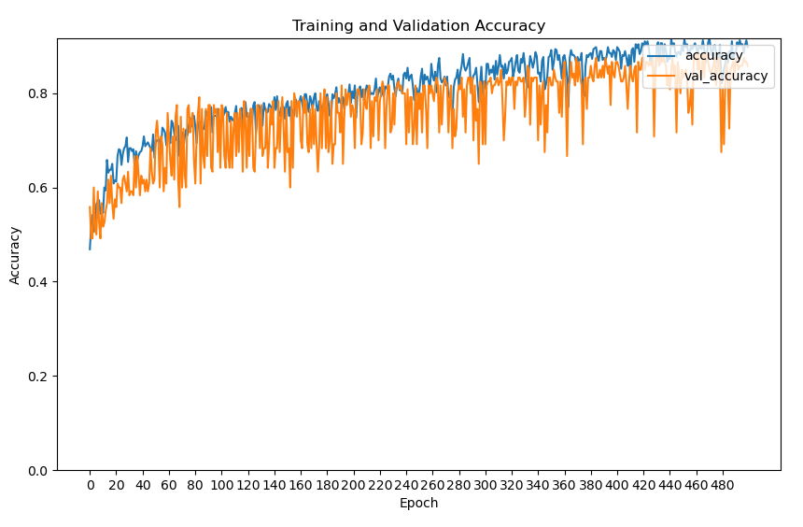
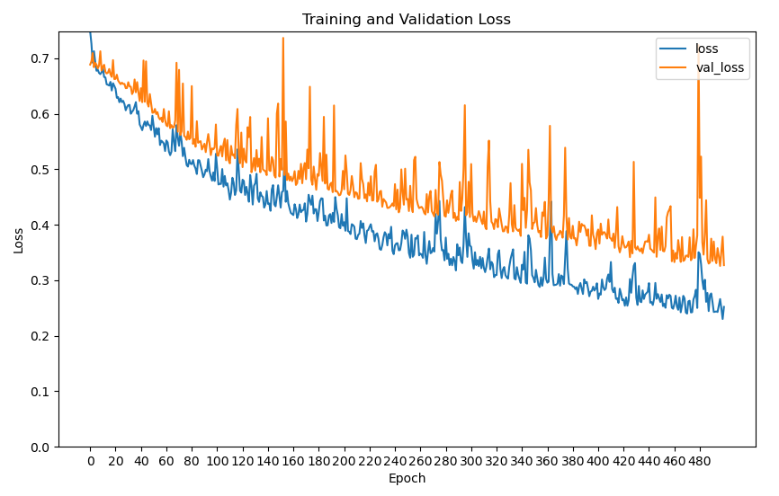
VGG16-AC(500epochs)
異常數: 600
正常數: 600
Heatmap光譜1x121(女性)
驗證集表現:
Learning rate = 0.0015
F1-Score: 0.8468
Recall: 0.7966

Slide 9
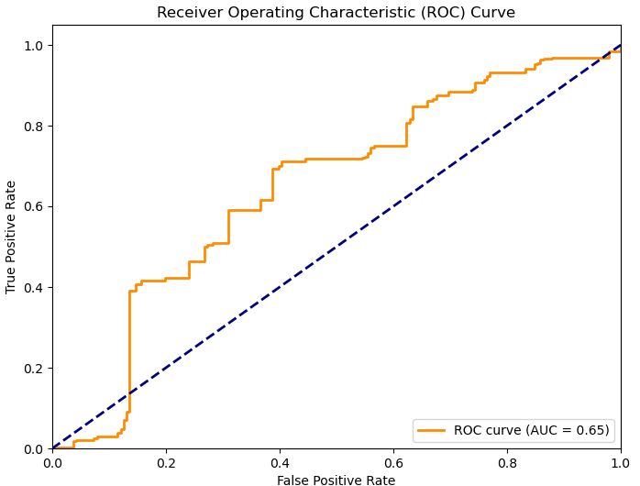
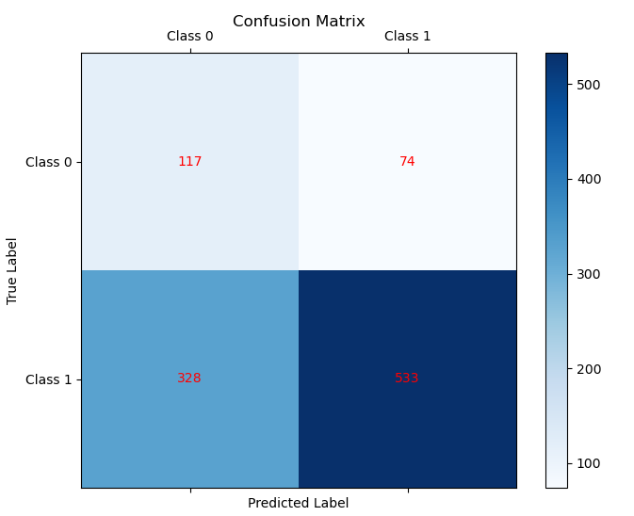
VGG16-AC(500epochs)
Heatmap光譜1x121(女性)
測試集表現:
F1-Score: 0.7262
Recall: 0.6190
precision recall f1-score support
Class 0 0.26 0.61 0.37 191
Class 1 0.88 0.62 0.73 861
accuracy 0.62 1052
macro avg 0.57 0.62 0.55 1052
weighted avg 0.77 0.62 0.66 1052

Slide 10
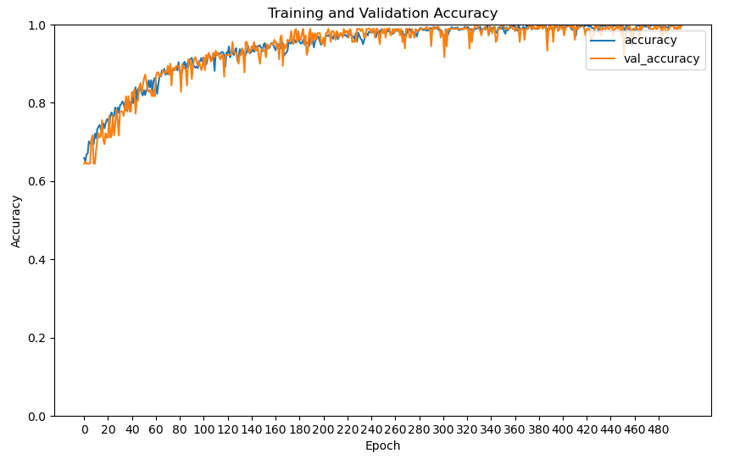
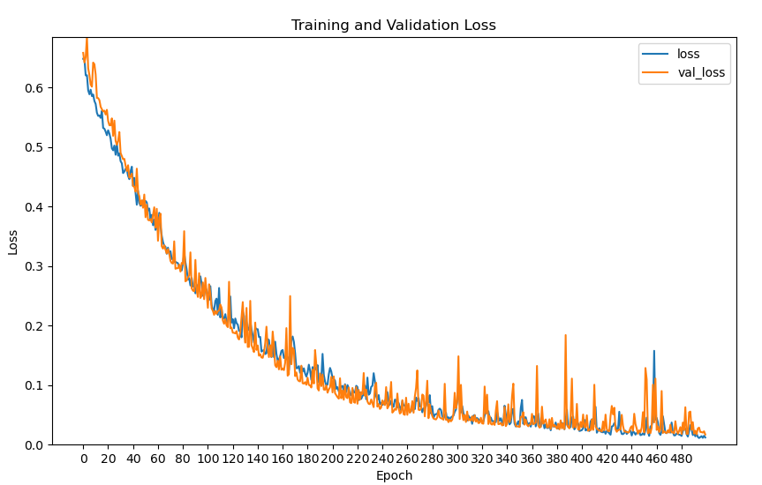
VGG16-AC(500epochs)
異常數: 597
正常數: 300
Heatmap光譜1x121(女性)
驗證集表現:
Learning rate = 0.001
F1-Score: 1.0000
Recall: 1.0000

Slide 11
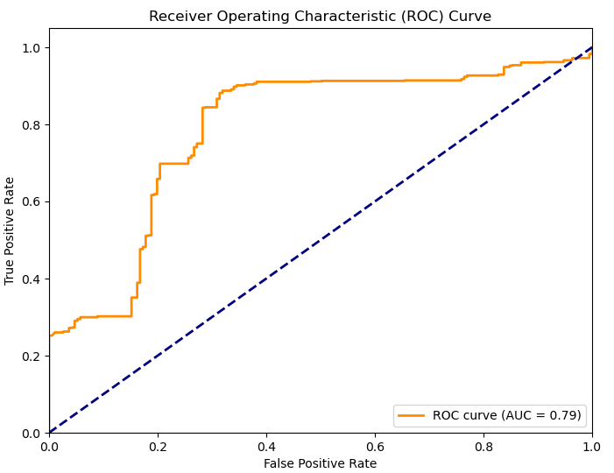
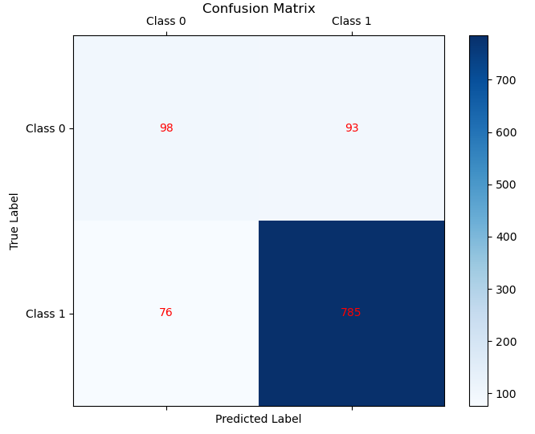
VGG16-AC(500epochs)
Heatmap光譜1x121(女性)
測試集表現:
F1-Score: 0.9028
Recall: 0.9117
precision recall f1-score support
Class 0 0.56 0.51 0.54 191
Class 1 0.89 0.91 0.90 861
accuracy 0.84 1052
macro avg 0.73 0.71 0.72 1052
weighted avg 0.83 0.84 0.84 1052

Slide 12
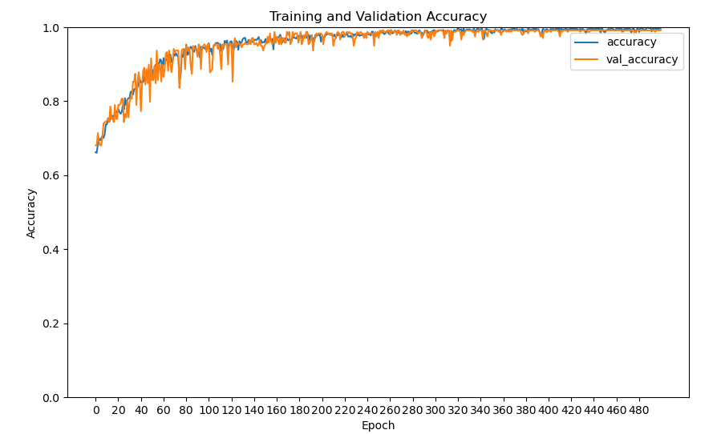
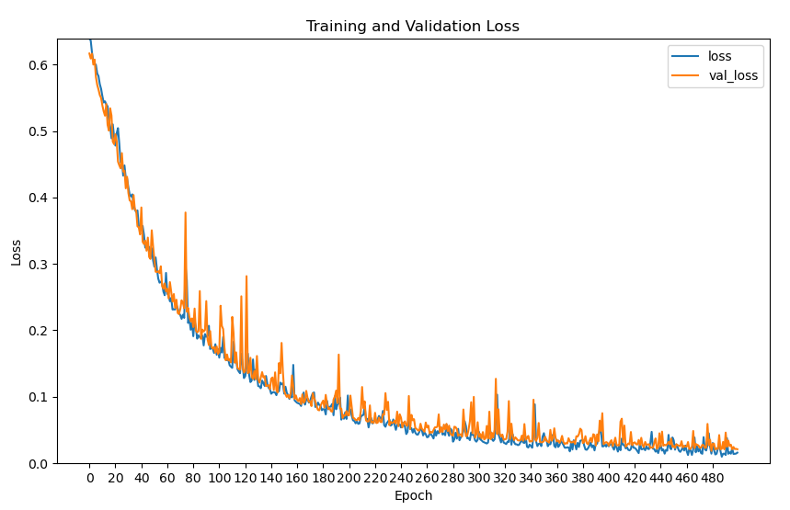
VGG16-AC(500epochs)
異常數: 803
正常數: 384
Heatmap光譜1x121(男性)
驗證集表現:
Learning rate = 0.001
F1-Score: 0.9938
Recall: 0.9938

Slide 13
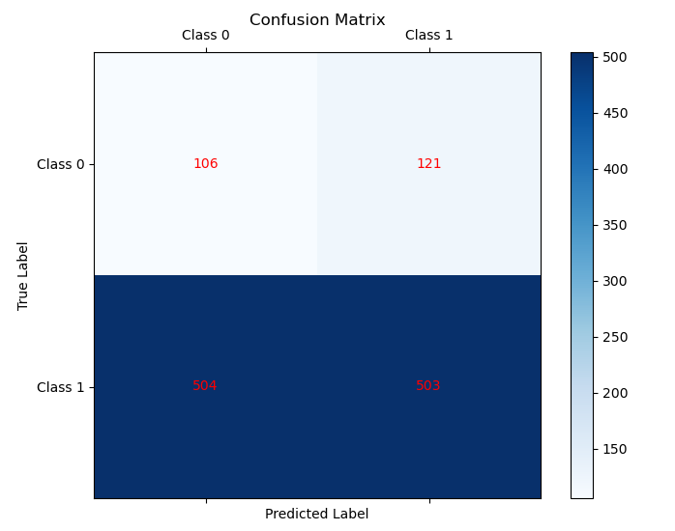
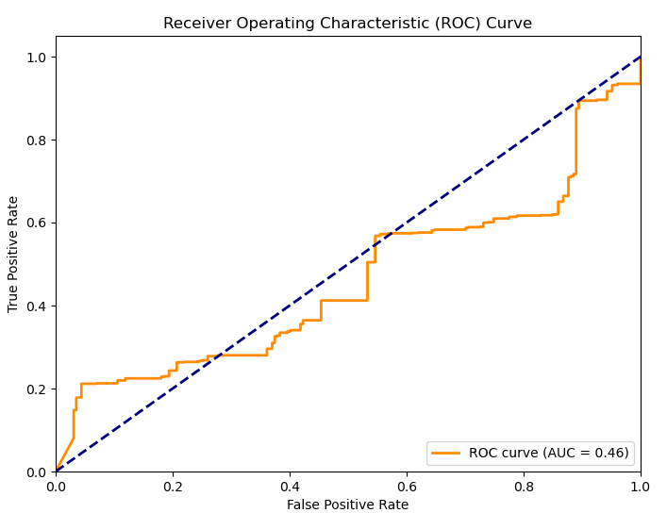
VGG16-AC(500epochs)
Heatmap光譜1x121(男性)
測試集表現:
F1-Score: 0.6168
Recall: 0.4995
precision recall f1-score support
Class 0 0.17 0.47 0.25 227
Class 1 0.81 0.50 0.62 1007
accuracy 0.49 1234
macro avg 0.49 0.48 0.44 1234
weighted avg 0.69 0.49 0.55 1234

Slide 14
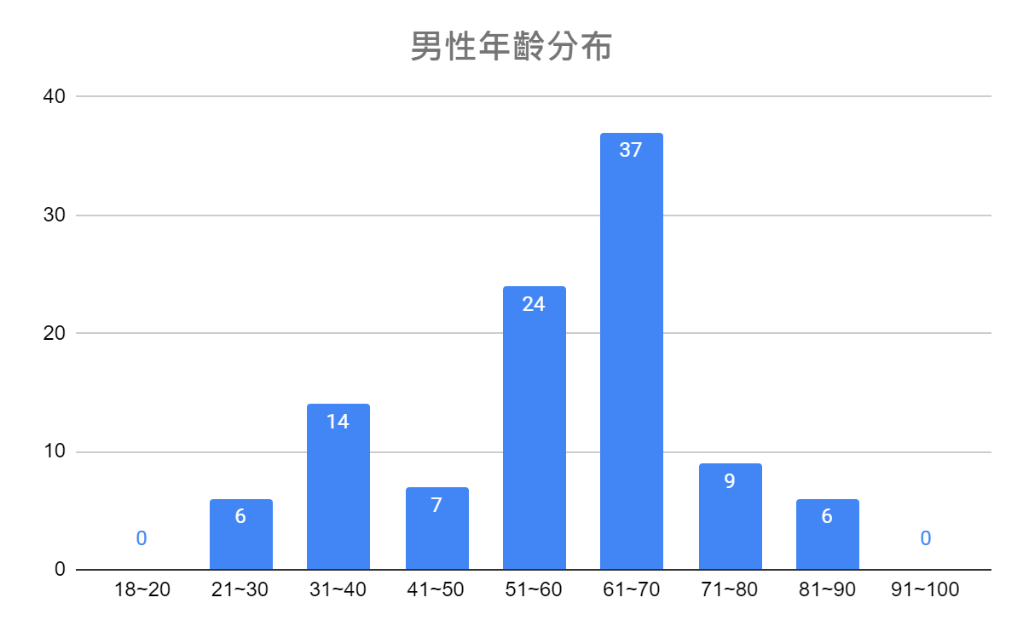
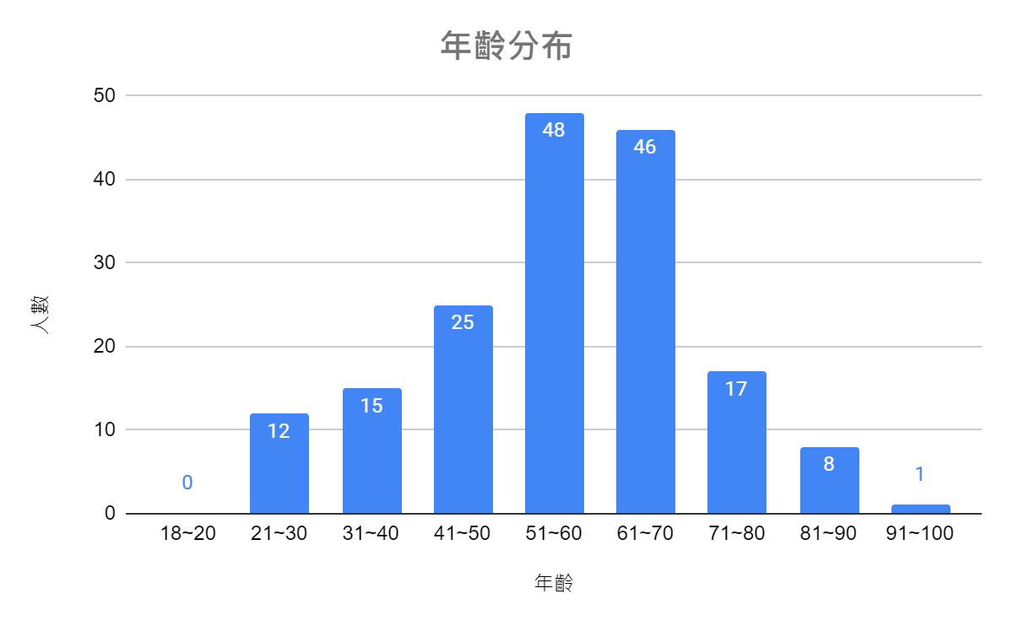
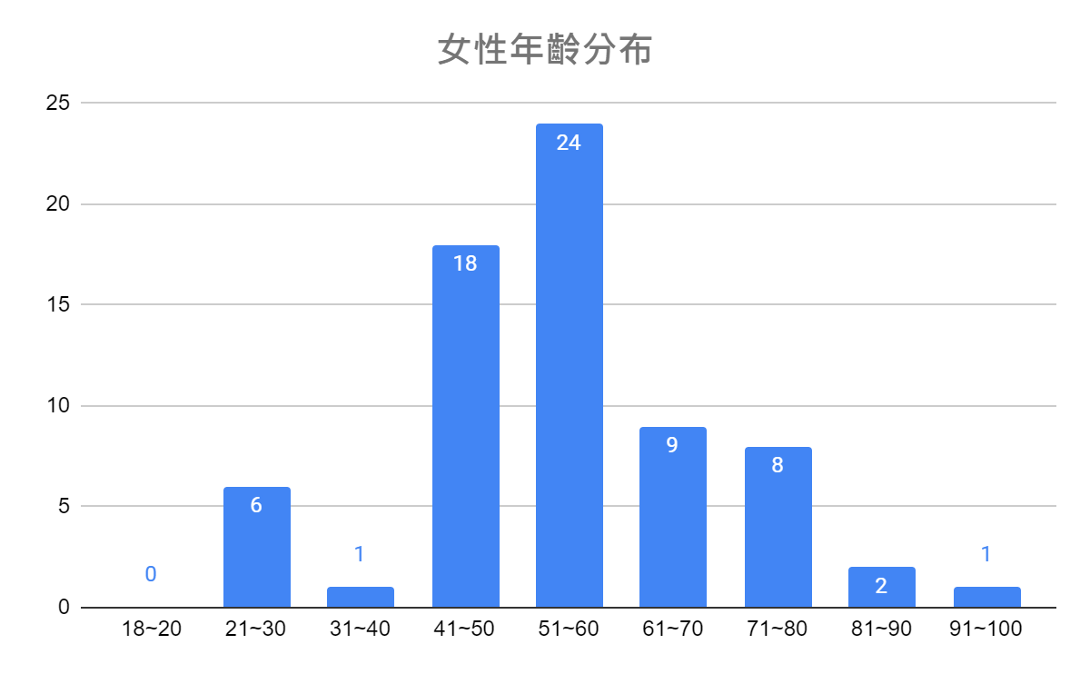
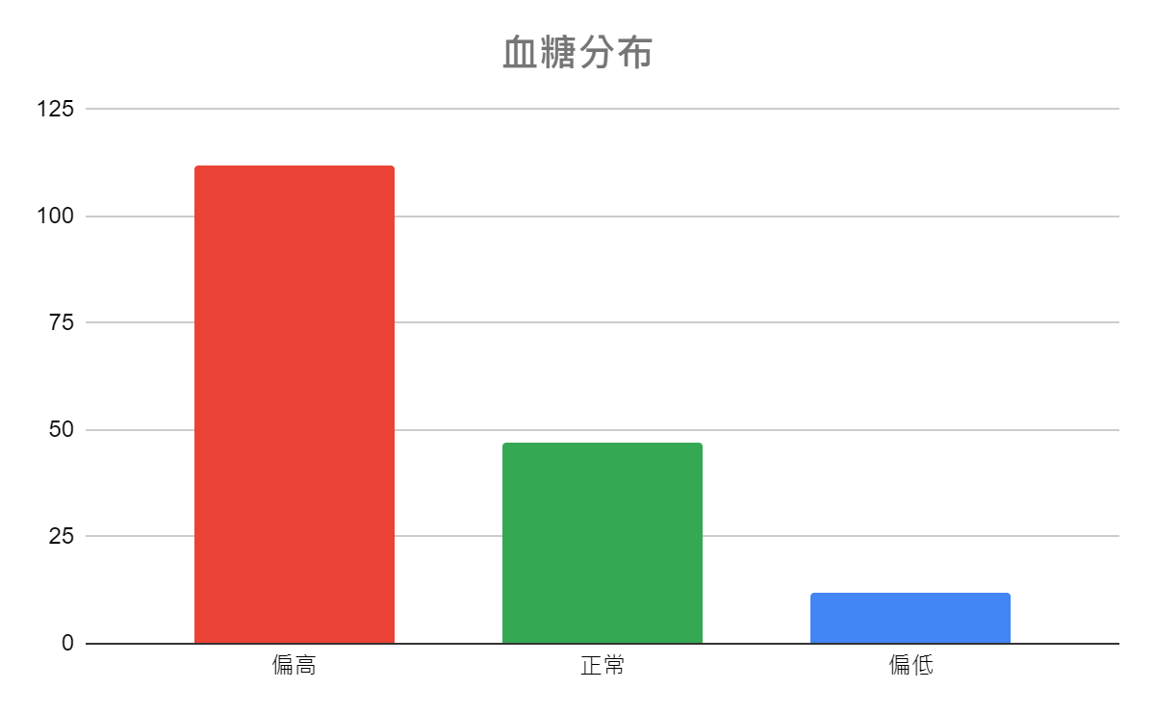
年齡分割討論
103人
約2060筆資料
172人
69人
約1380筆資料

Slide 15
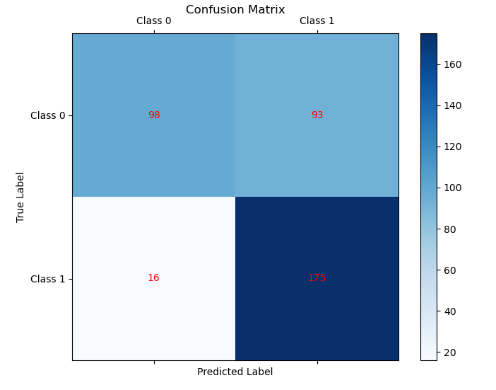
VGG16-AC(500epochs)
Heatmap光譜1x121(女性)
測試集表現:
F1-Score: 0.7625
Recall: 0.9162
precision recall f1-score support
Class 0 0.86 0.51 0.64 191
Class 1 0.65 0.92 0.76 191
accuracy 0.71 382
macro avg 0.76 0.71 0.70 382
weighted avg 0.76 0.71 0.70 382

