Slide 1
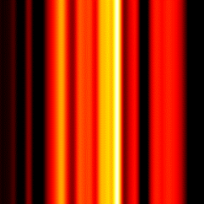
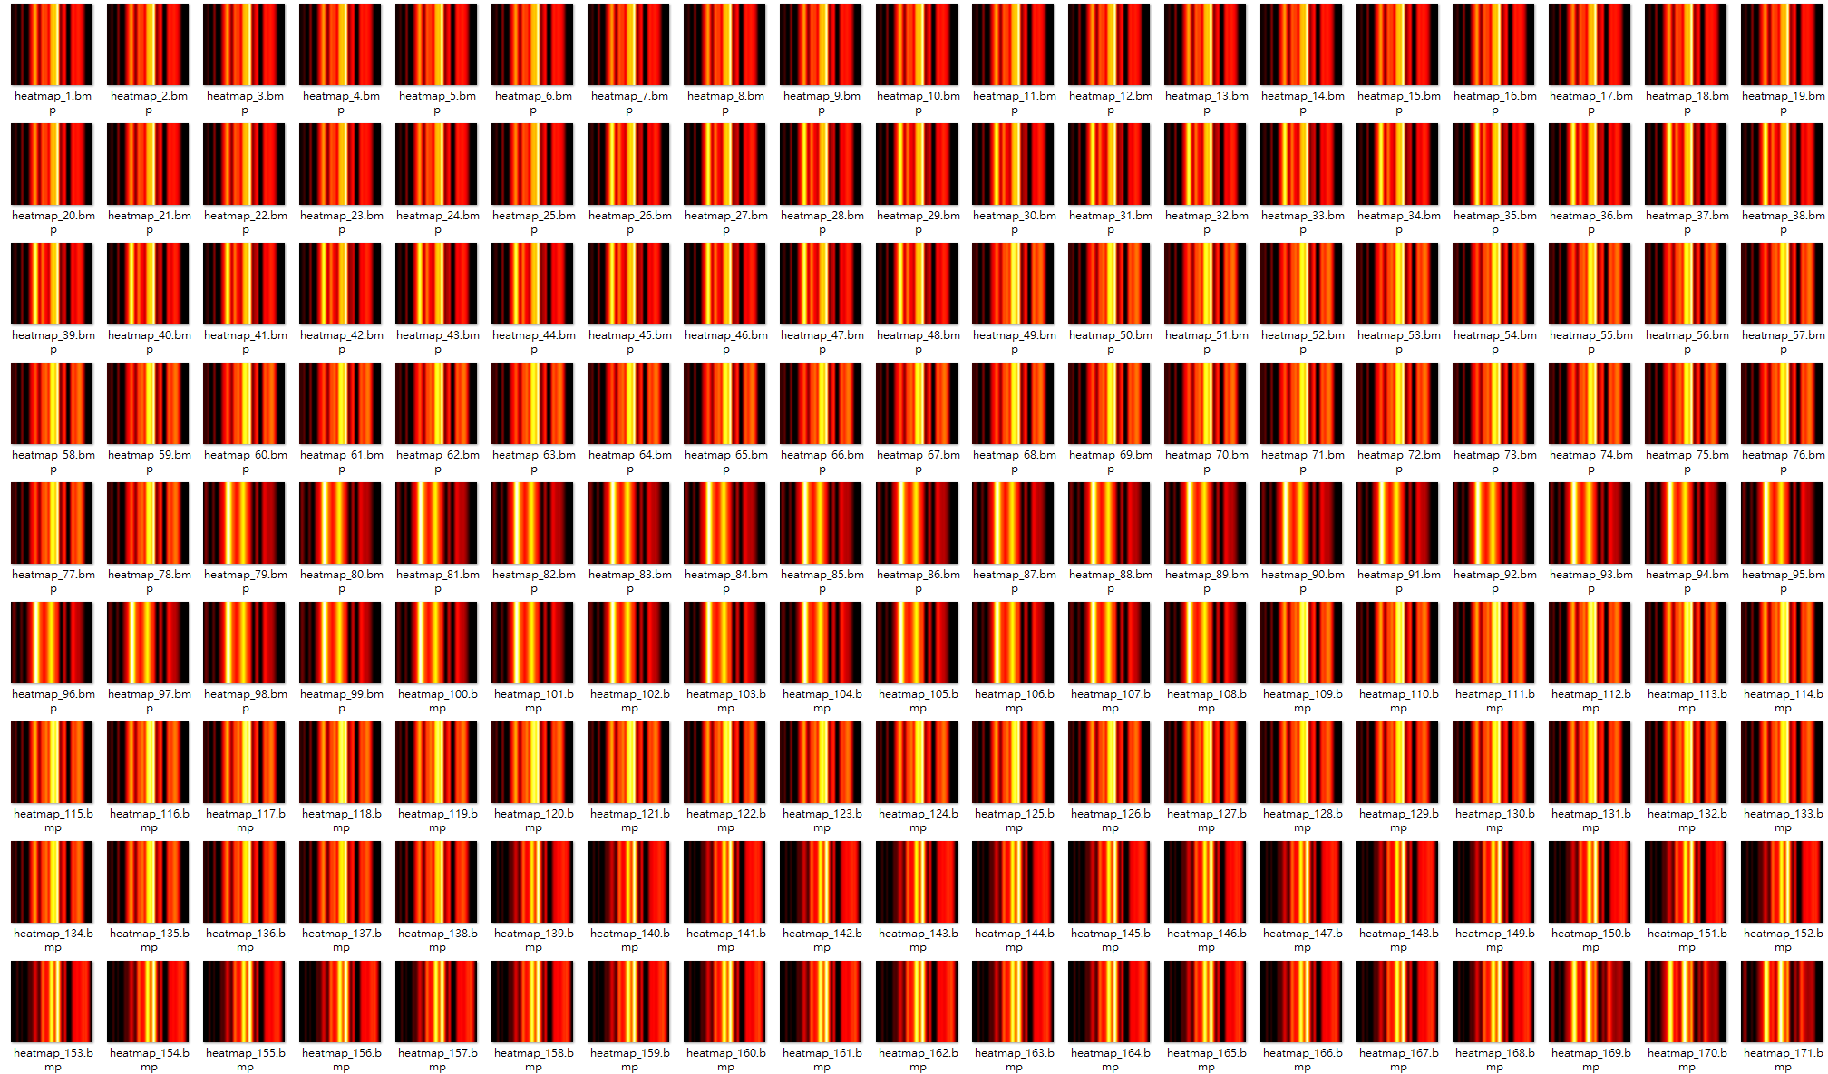
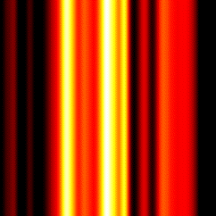
單筆光譜(1x121)
受試者A
受試者B

Slide 2
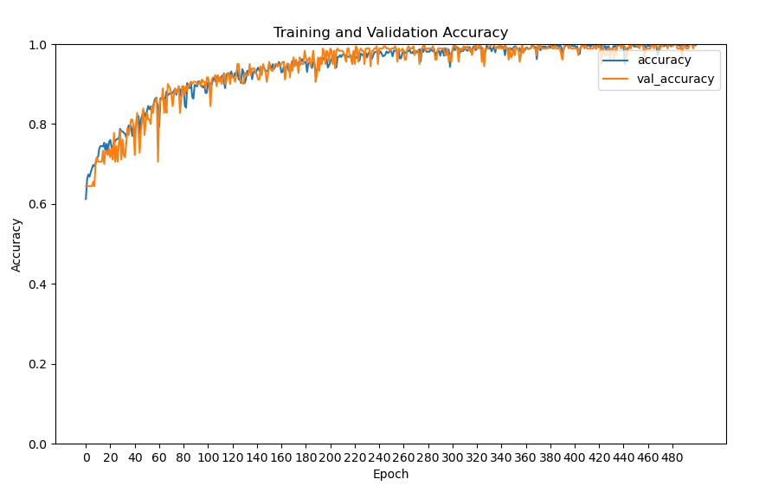
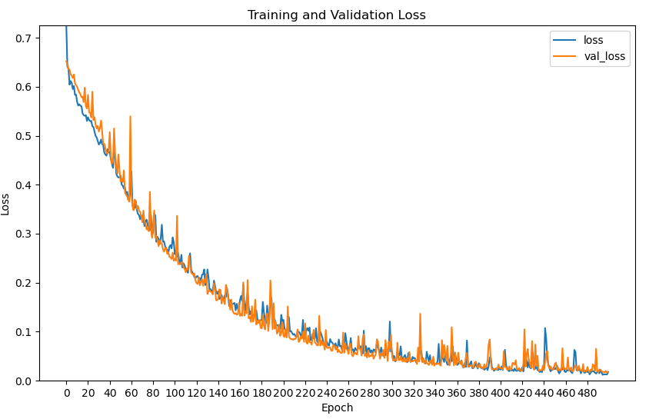
VGG16-AC(500epochs)
異常數: 300
正常數: 300
Heatmap光譜1x121(女性)
驗證集表現:
Learning rate = 0.001
F1-Score: 0.9915
Recall: 0.9831

Slide 3
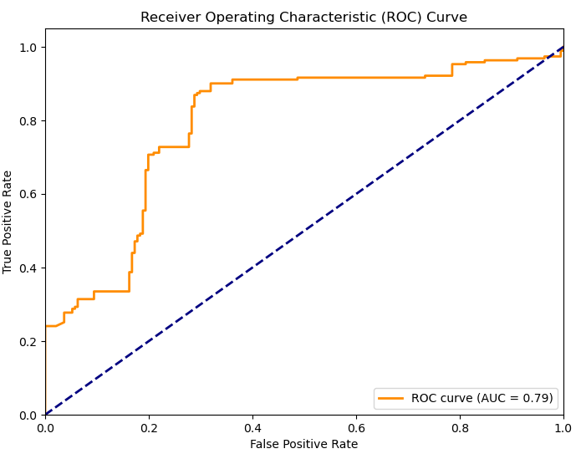
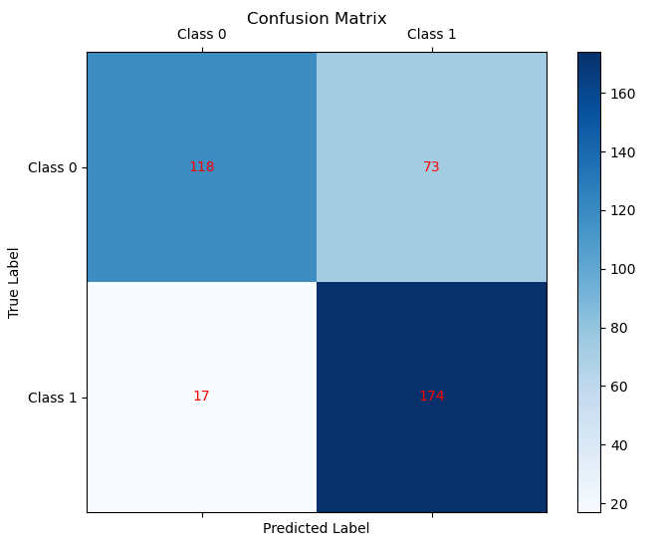
VGG16-AC(500epochs)
Heatmap光譜1x121(女性)
測試集表現:
F1-Score: 0.7945
Recall: 0.9110
precision recall f1-score support
Class 0 0.87 0.62 0.72 191
Class 1 0.70 0.91 0.79 191
accuracy 0.76 382
macro avg 0.79 0.76 0.76 382
weighted avg 0.79 0.76 0.76 382

Slide 4
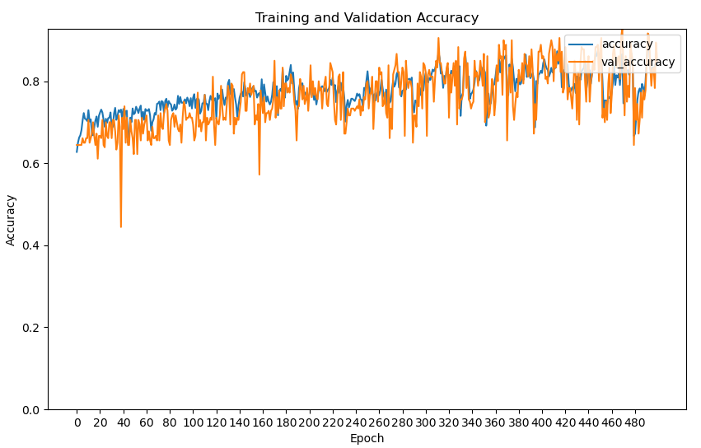
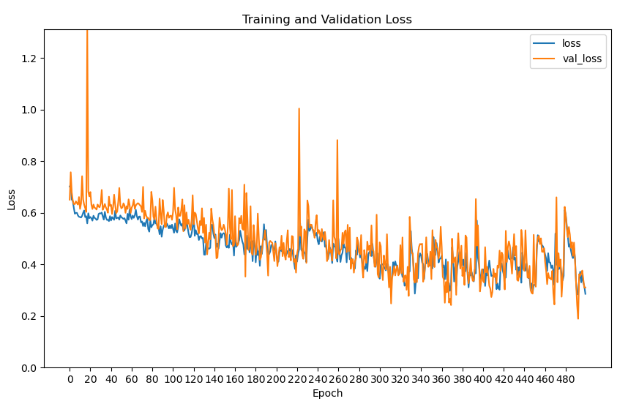
VGG16-AC(500epochs)
異常數: 300
正常數: 300
Heatmap光譜1x121(女性)
驗證集表現:
Learning rate = 0.001
F1-Score: 0.9915
Recall: 0.9831

Slide 5
VGG16-AC(500epochs)
Heatmap光譜1x121(女性)
測試集表現:
F1-Score: 0.7945
Recall: 0.9110
precision recall f1-score support
Class 0 0.87 0.62 0.72 191
Class 1 0.70 0.91 0.79 191
accuracy 0.76 382
macro avg 0.79 0.76 0.76 382
weighted avg 0.79 0.76 0.76 382

Slide 6
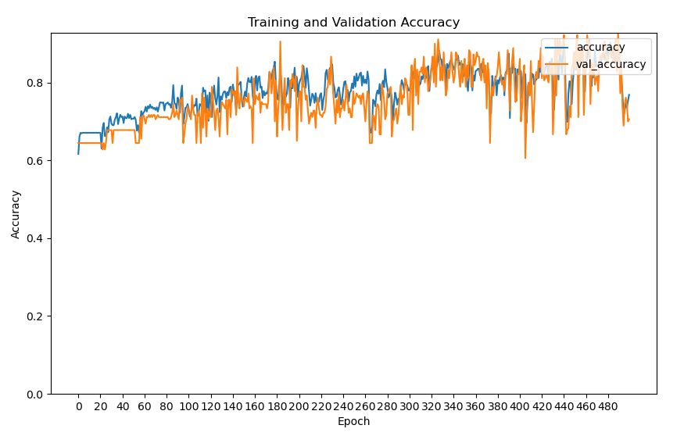
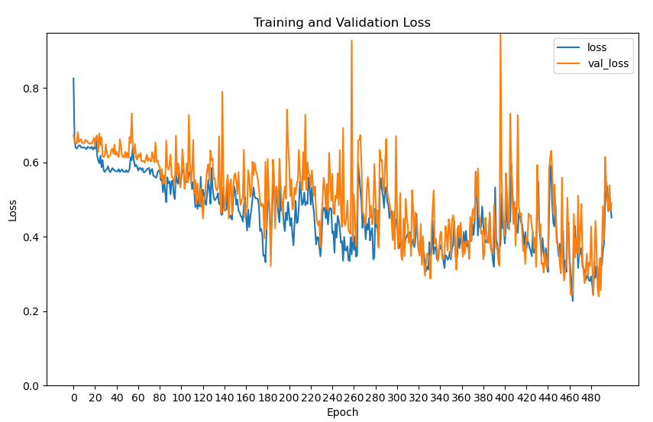
VGG16-AC(500epochs)
異常數: 300
正常數: 300
Heatmap光譜1x121(女性)
驗證集表現:
Learning rate = 0.001
F1-Score: 0.9915
Recall: 0.9831

Slide 7
VGG16-AC(500epochs)
Heatmap光譜1x121(女性)
測試集表現:
F1-Score: 0.7945
Recall: 0.9110
precision recall f1-score support
Class 0 0.87 0.62 0.72 191
Class 1 0.70 0.91 0.79 191
accuracy 0.76 382
macro avg 0.79 0.76 0.76 382
weighted avg 0.79 0.76 0.76 382

