Slide 1
0530黃疸貧血交接

Slide 2
模型MWPPG001~63貧血

Slide 3
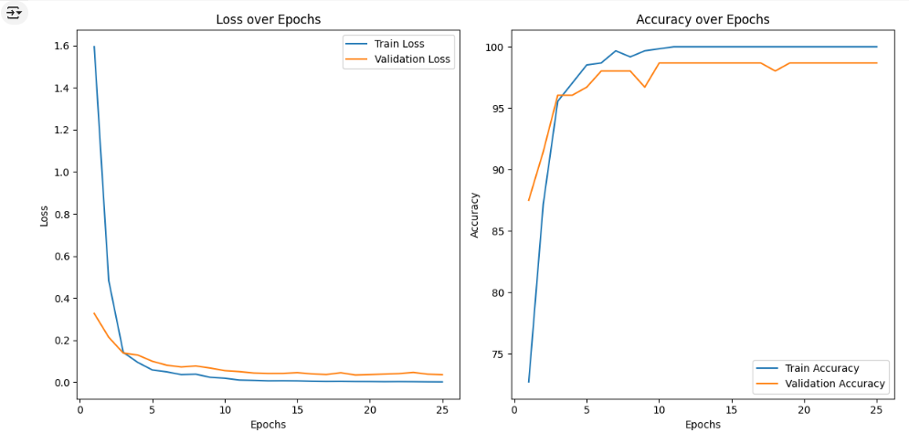
未去反光

Slide 4
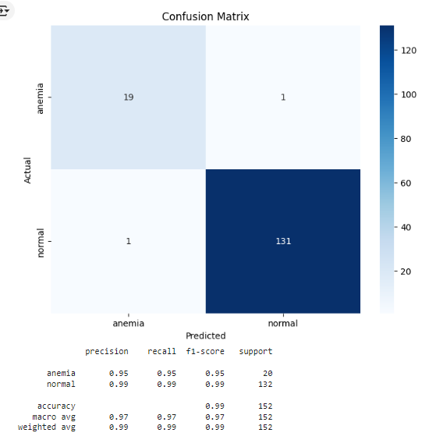
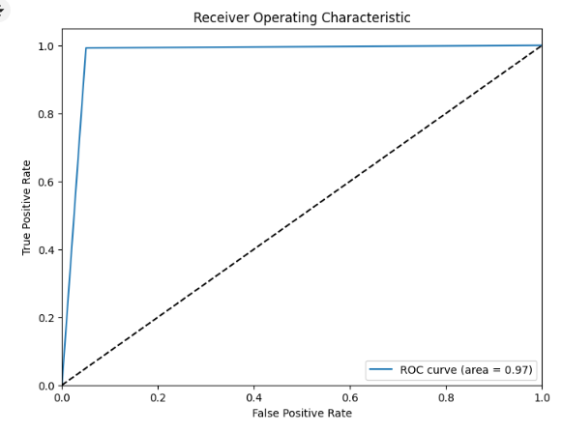
未去反光

Slide 5
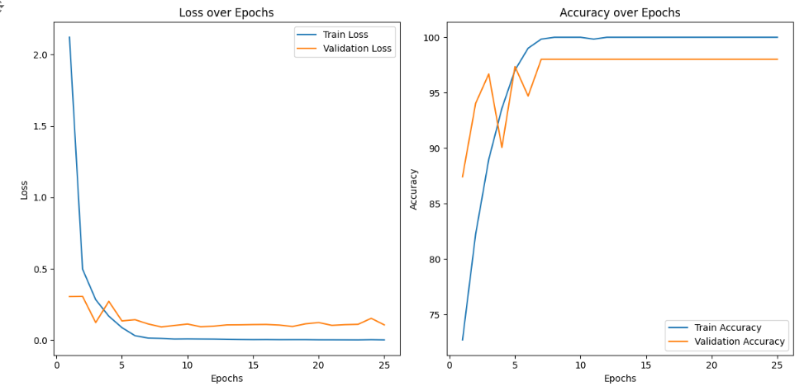
去反光

Slide 6
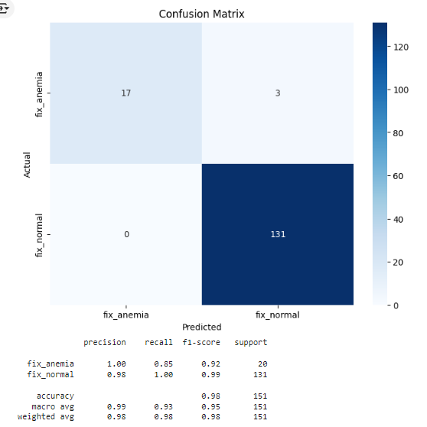
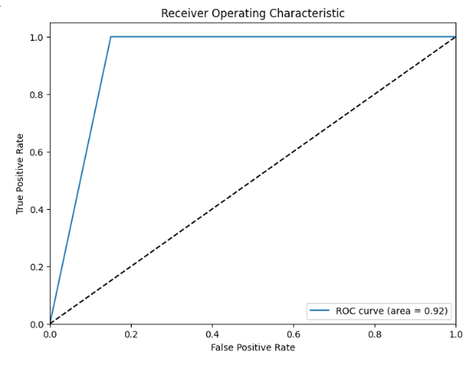
去反光

Slide 7
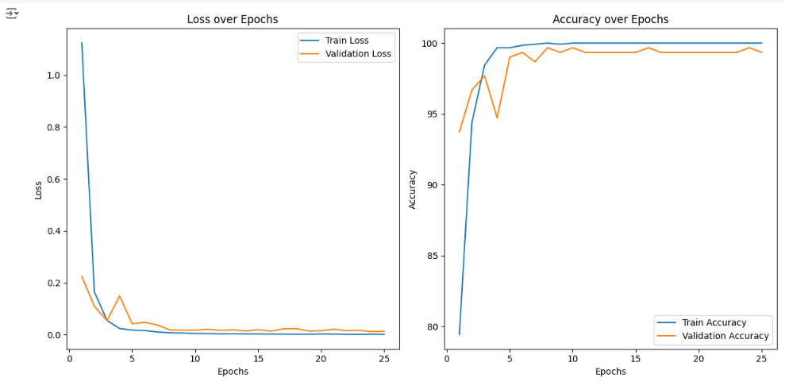
混和

Slide 8
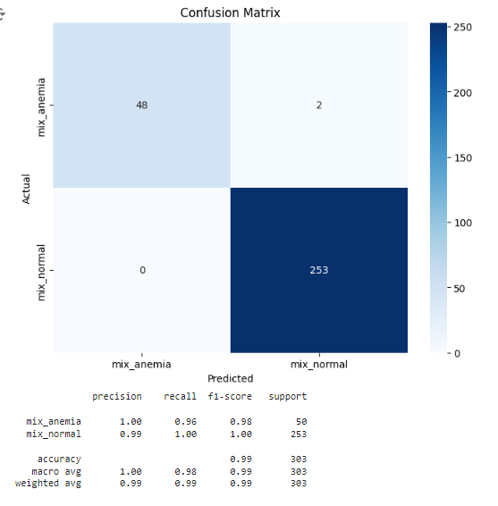
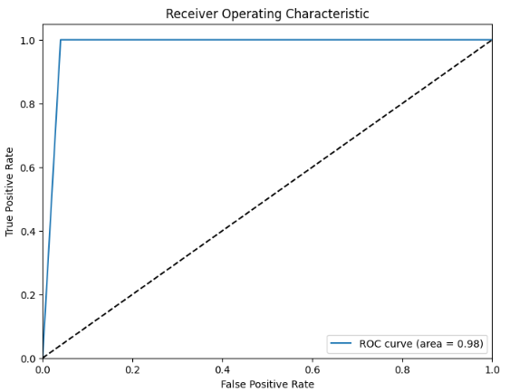
混和

Slide 9
0604黃疸貧血交接

Slide 10
模型MWPPG088~100貧血

Slide 11
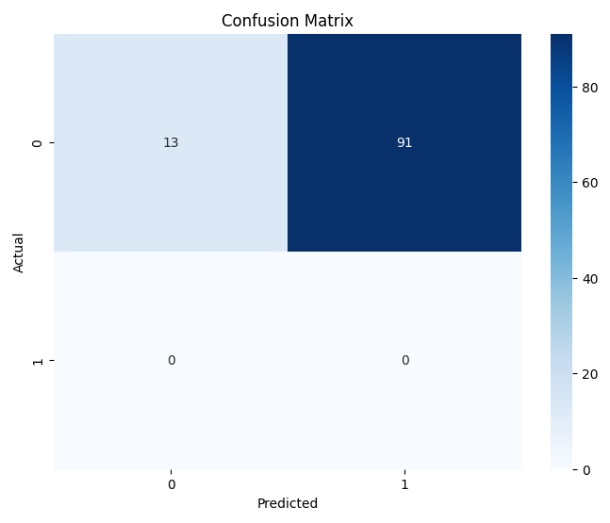
未去反光iPhone只有眼瞼Test

Slide 12
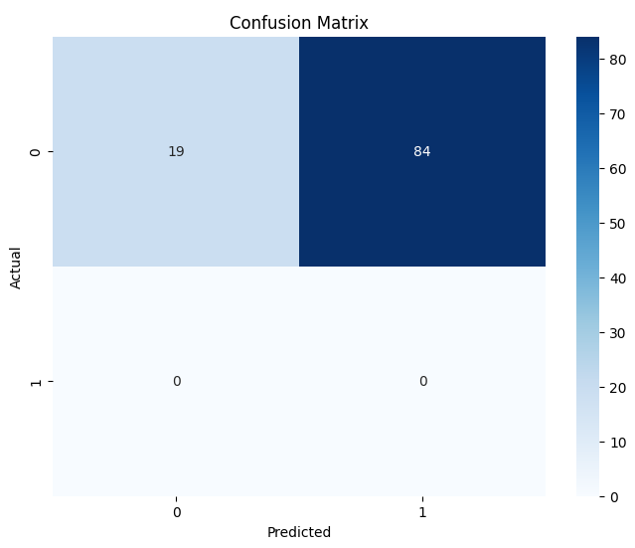
去反光iPhone只有眼瞼Test

Slide 13
未去反光Samsung只有眼瞼Test

Slide 14
去反光Samsung只有眼瞼Test

Slide 15
App

Slide 16
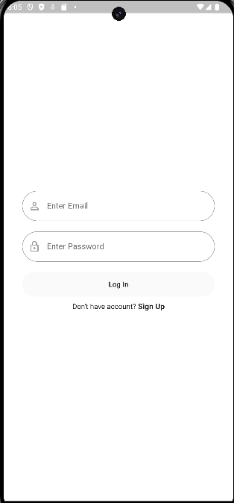
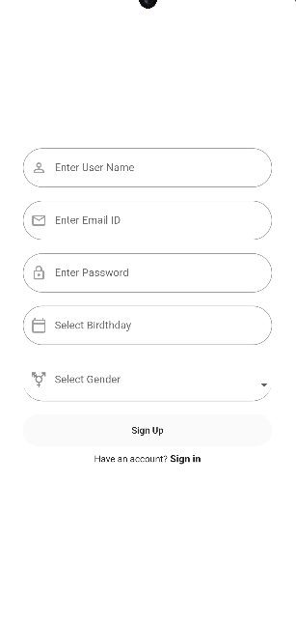

Slide 18
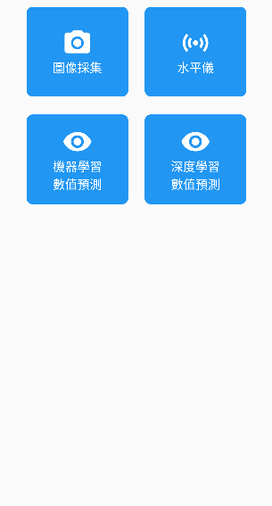

Slide 19
0618黃疸貧血交接

Slide 20
模型黃疸

Slide 21
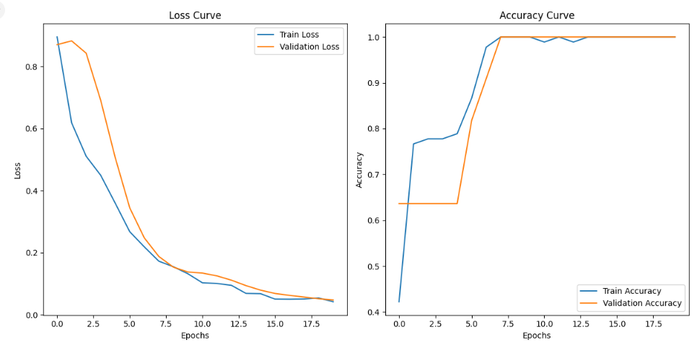
未去反光

Slide 22
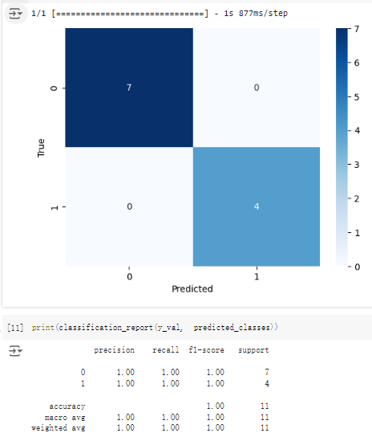
未去反光

Slide 23
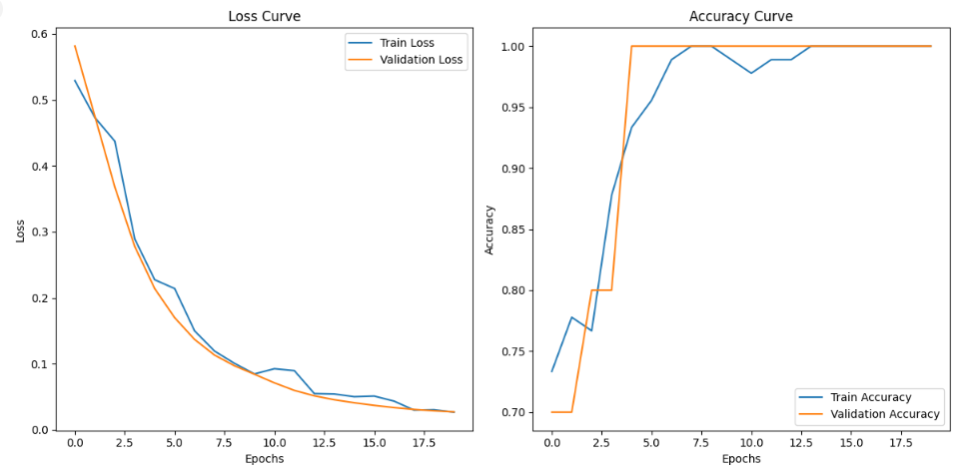
去反光

Slide 24
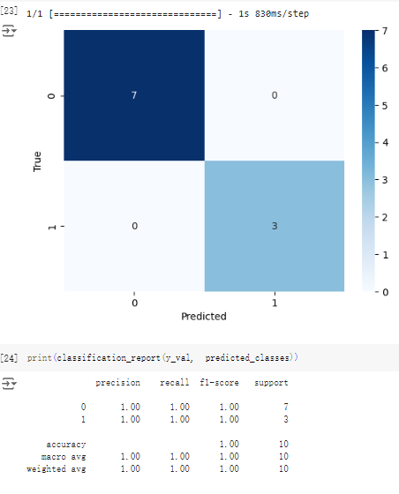
去反光

Slide 25
0625黃疸貧血交接

Slide 26
Unet

Slide 27
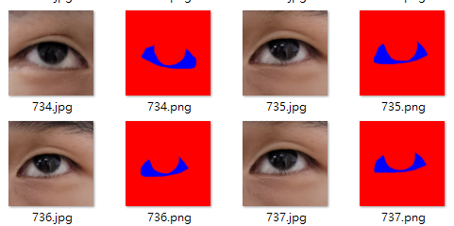
標記眼白
使用GIMP標記眼白部分，標記完後改編號將其加入資料集訓練。

Slide 28
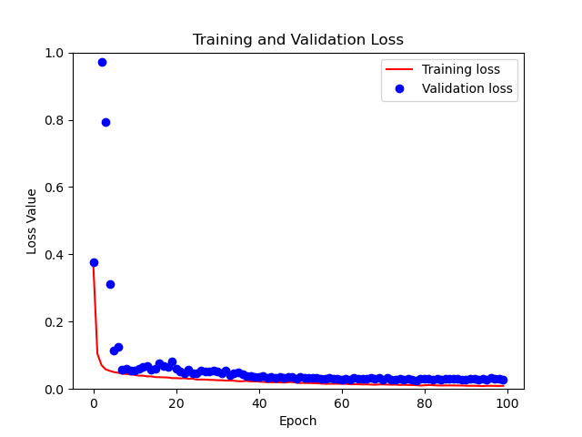
訓練結果

Slide 29
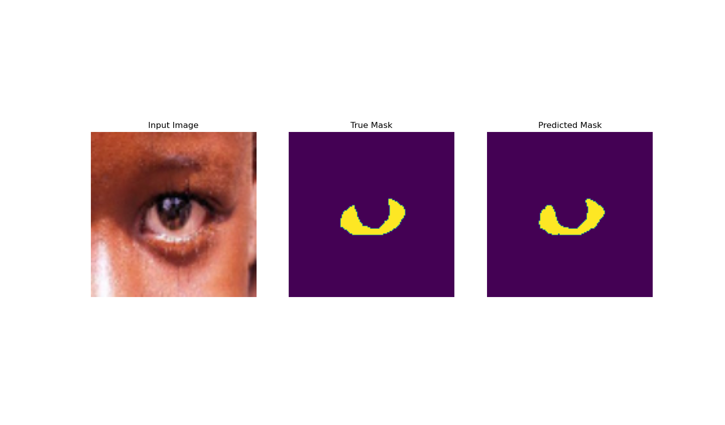
訓練結果

Slide 30
0702黃疸貧血交接

Slide 31
App

Slide 32
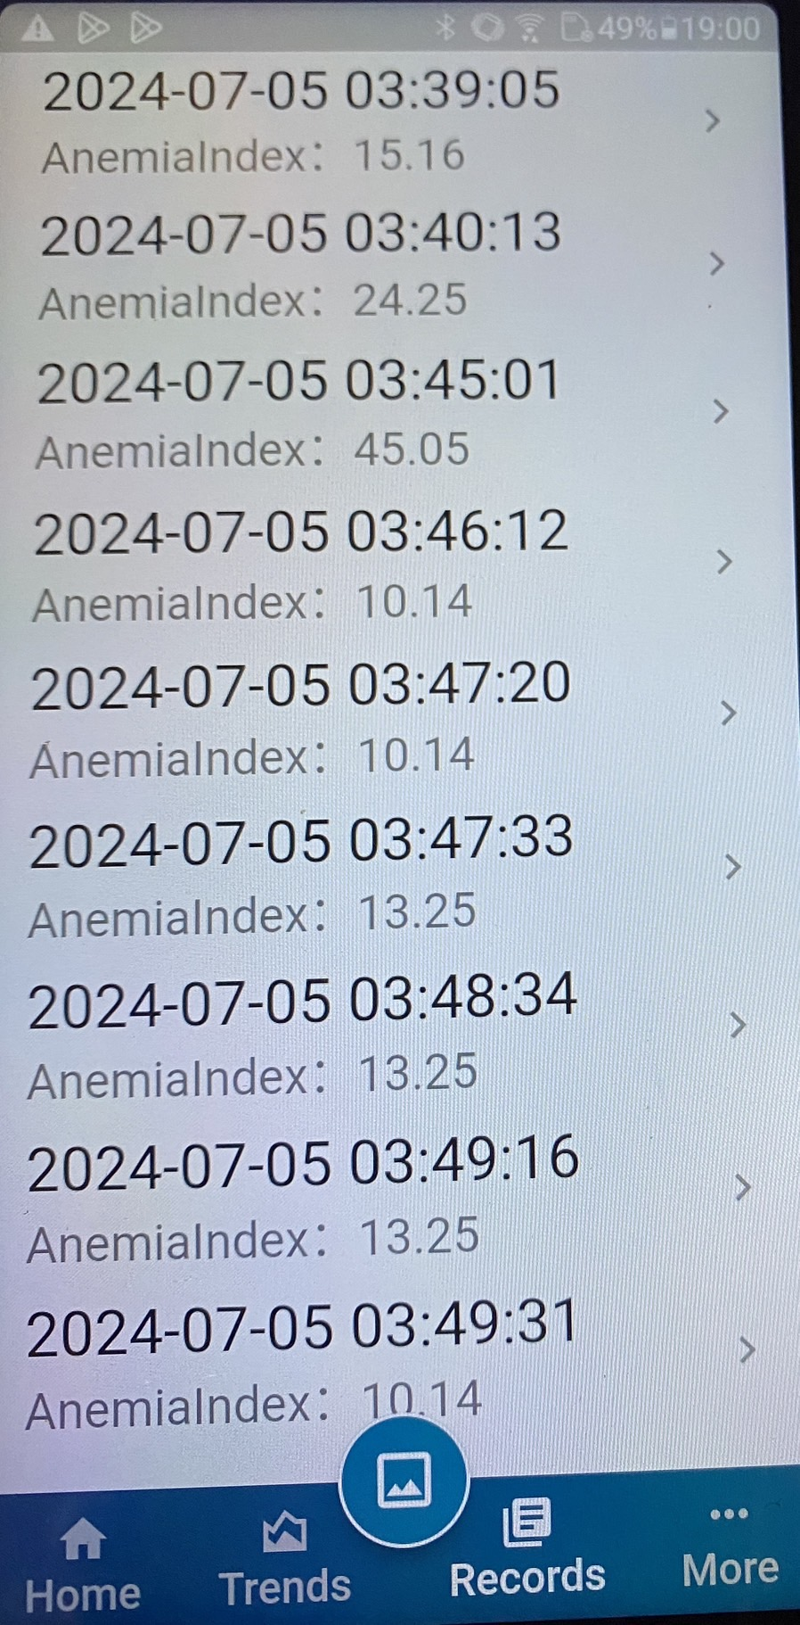
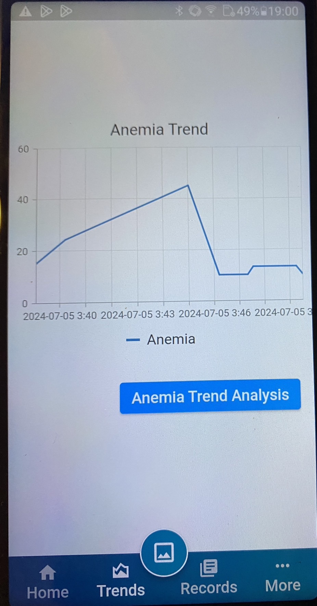

Slide 33
0716交接

Slide 34
PPG模型-SH

Slide 35
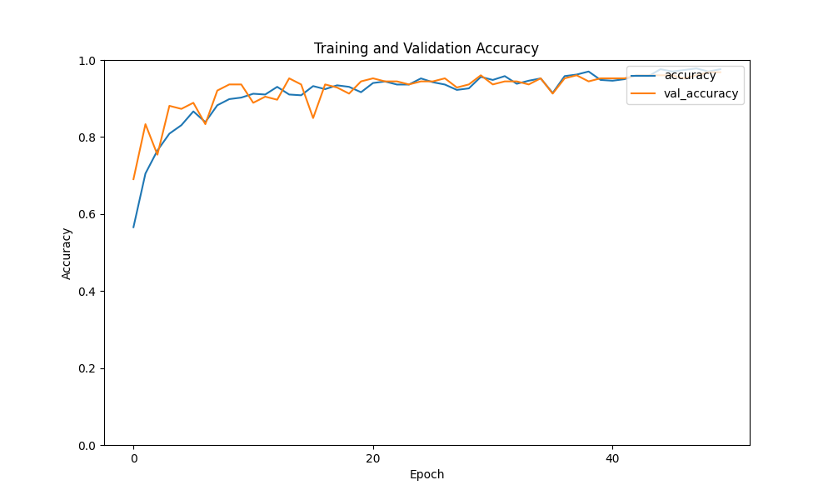
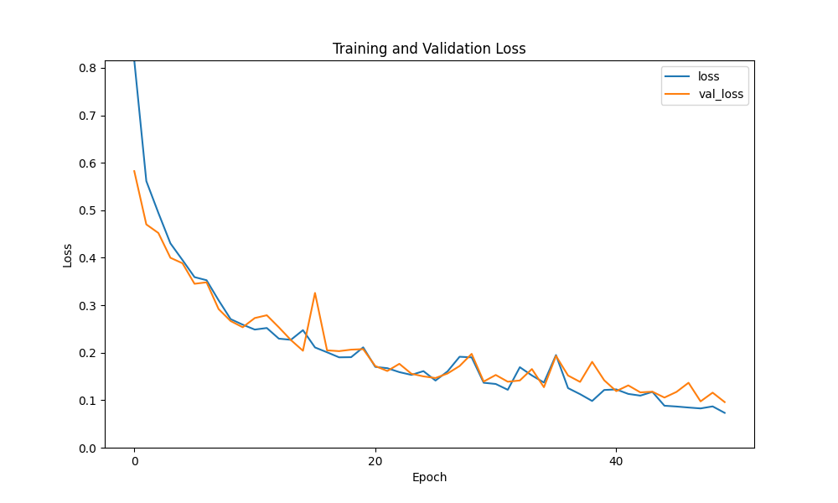
GoogLeNet-SH-2Class-Male

Slide 36
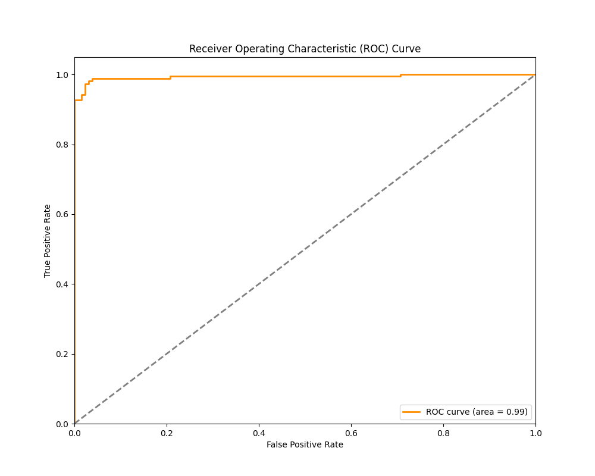
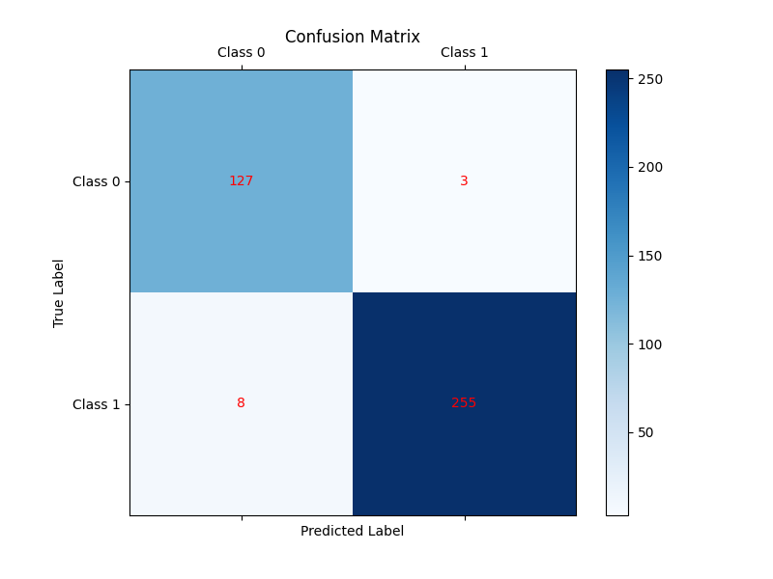
GoogLeNet-SH-2Class-Male

Slide 37
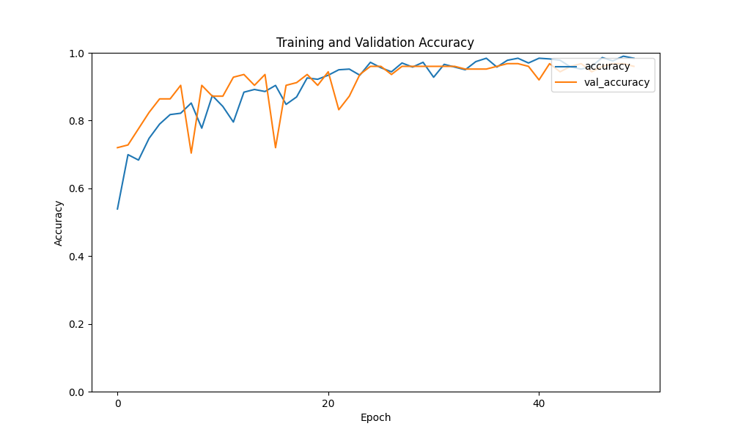
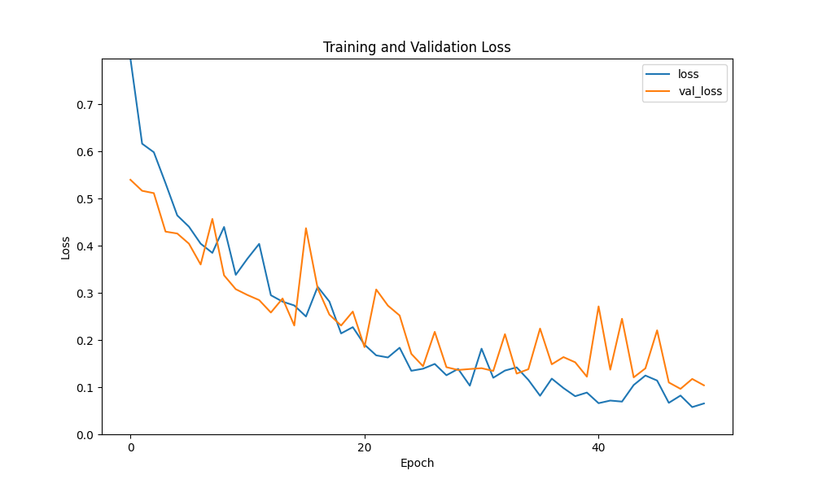
GoogLeNet-SH-2Class-Female

Slide 38
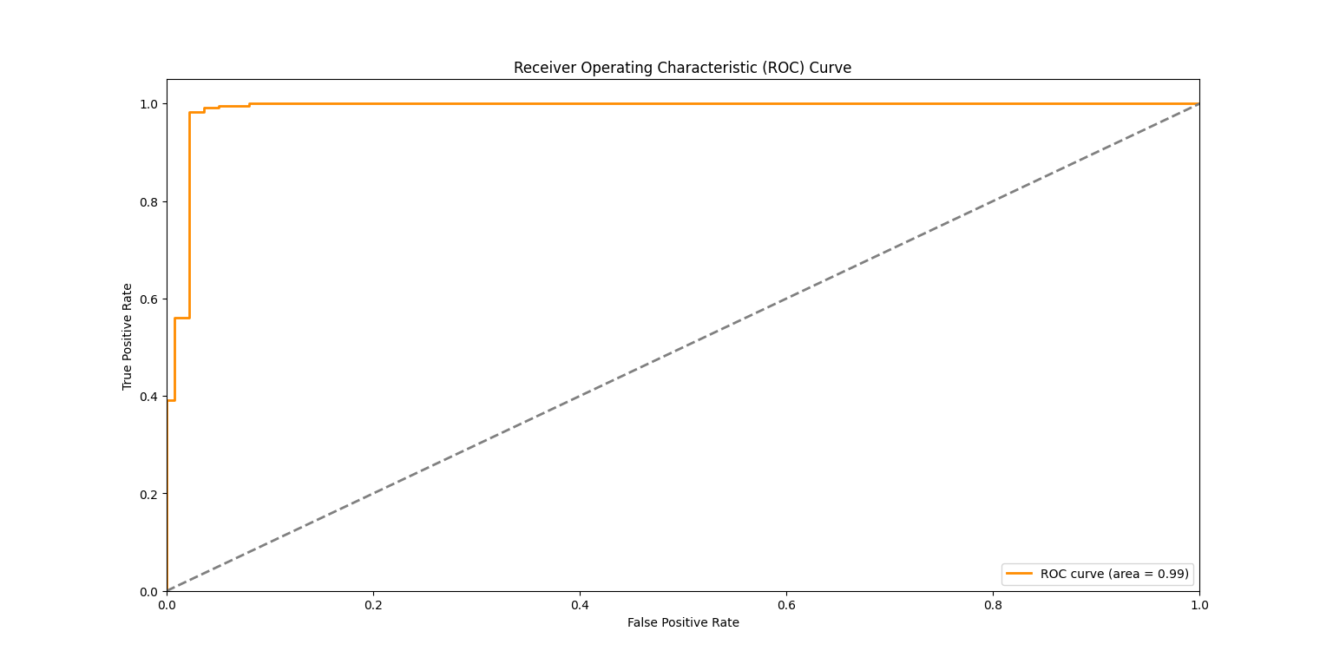
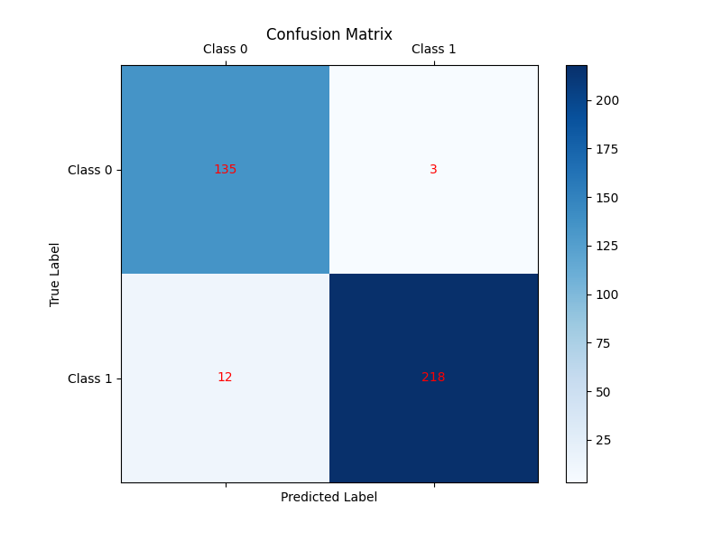
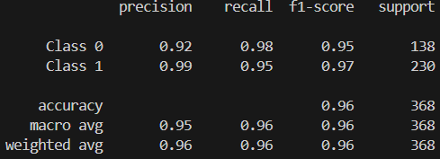
GoogLeNet-SH-2Class-Female

Slide 39
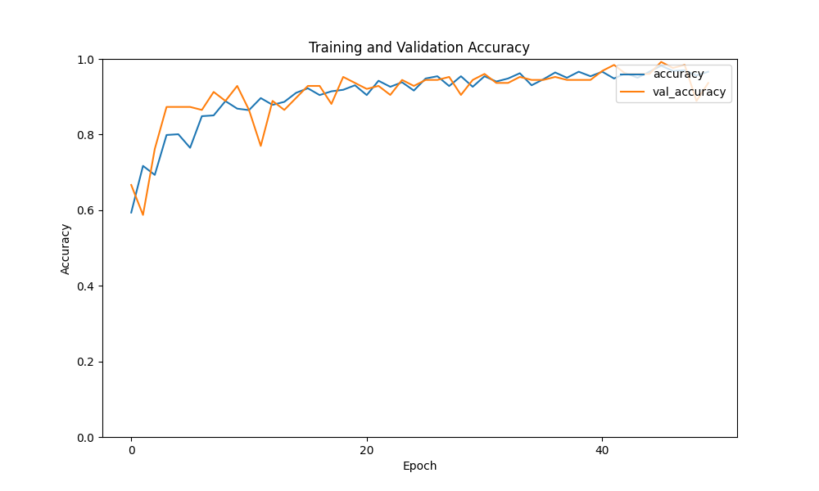
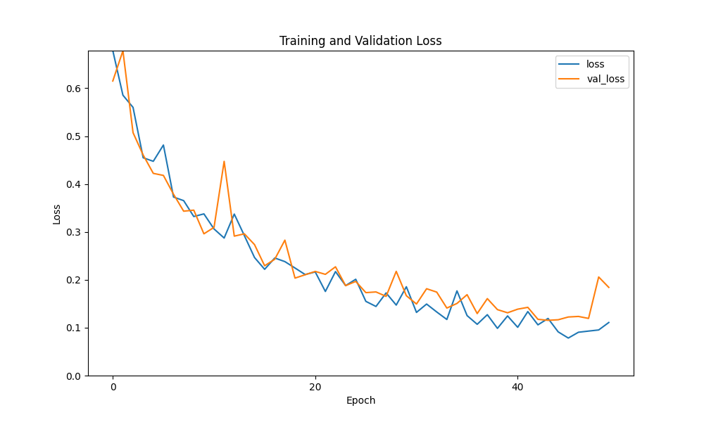
ResNet-SH-2Class-Male

Slide 40
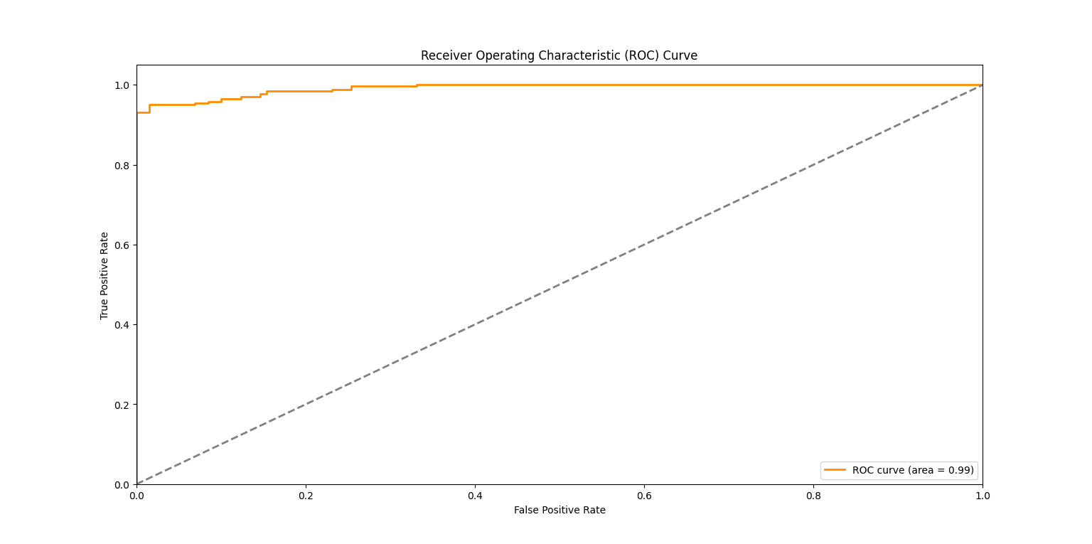
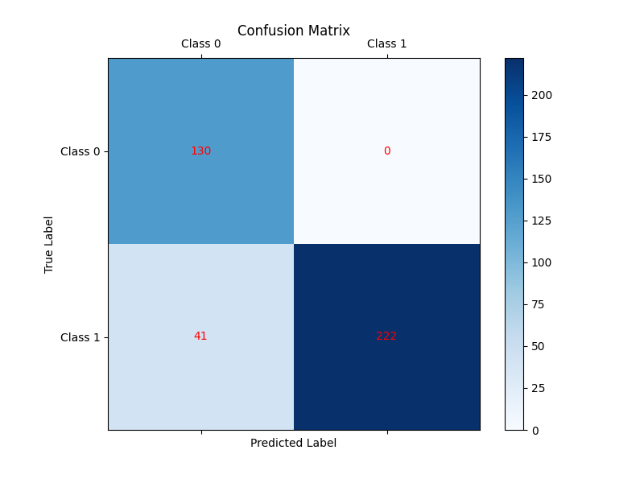
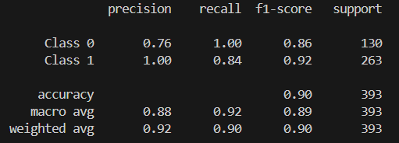
ResNet-SH-2Class-Male

Slide 41
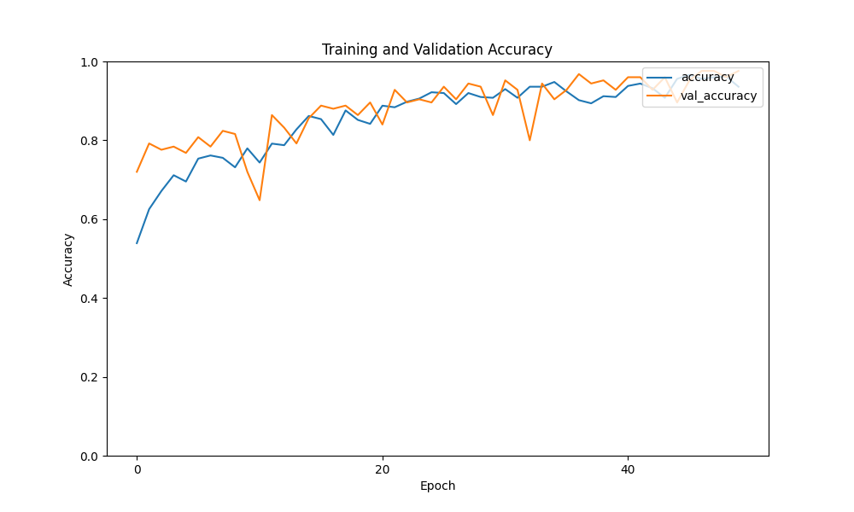
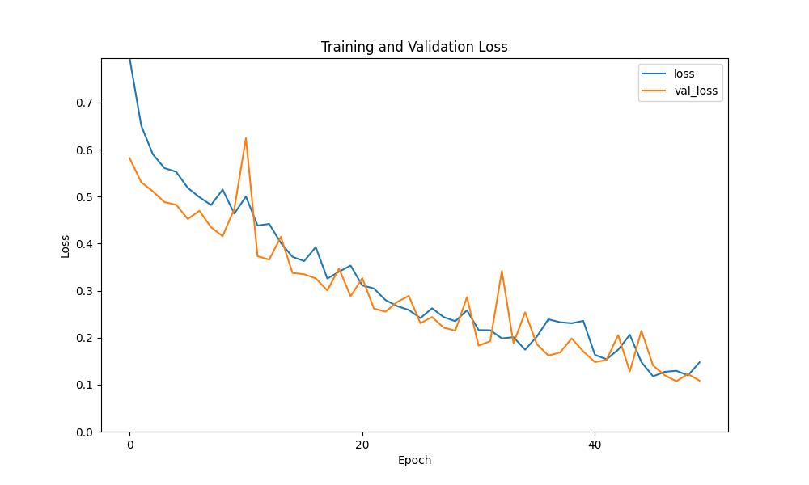
ResNet-SH-2Class-Female

Slide 42
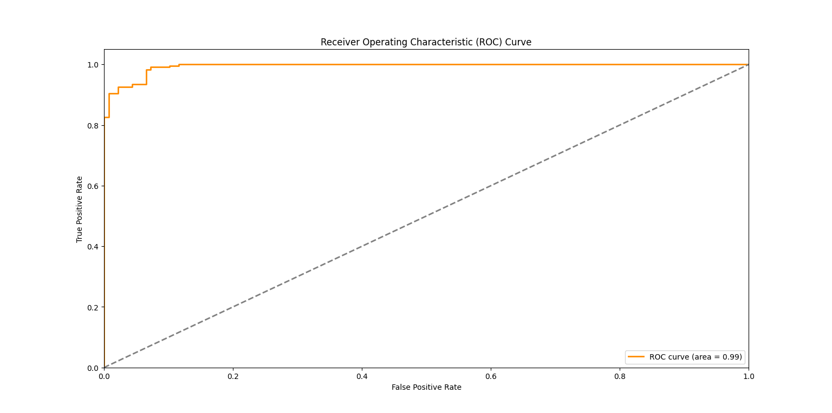
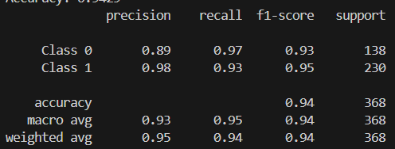
ResNet-SH-2Class-Female

Slide 43
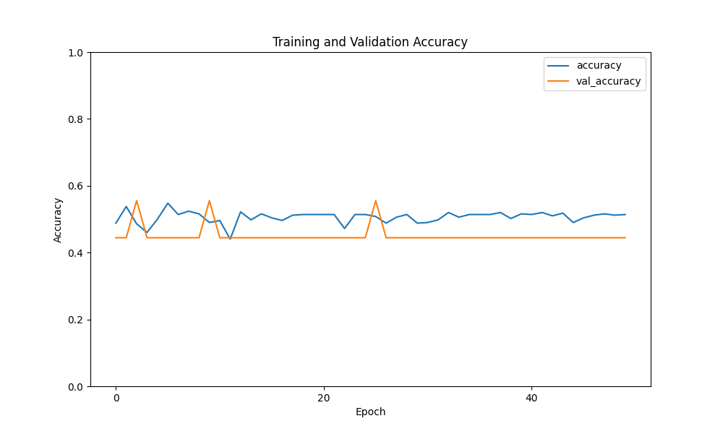
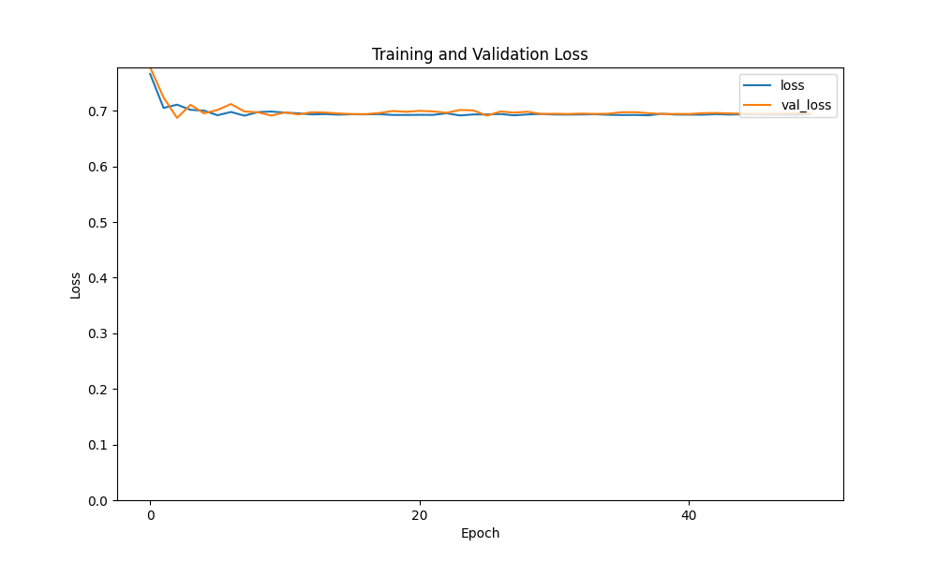
EfficientNet-SH-2Class-Male

Slide 44
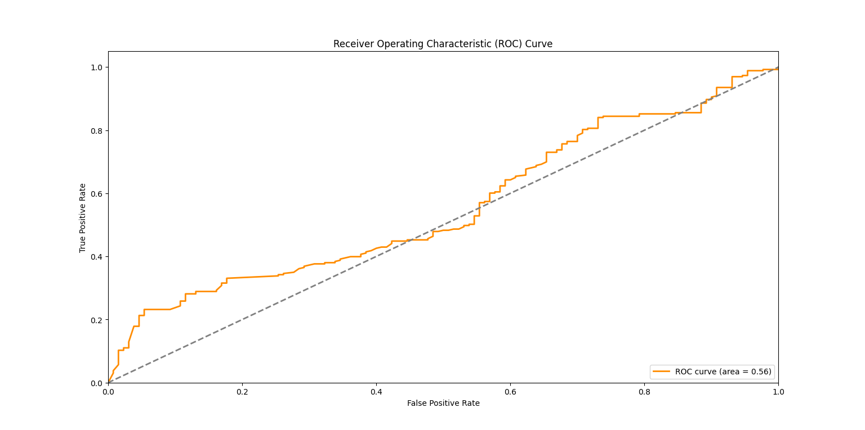
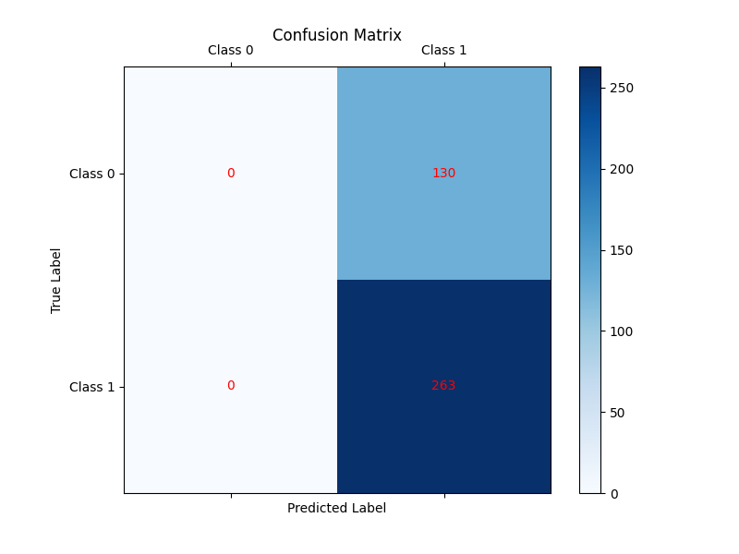
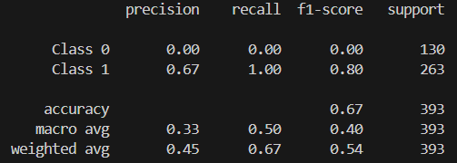
EfficientNet-SH-2Class-Male

Slide 45
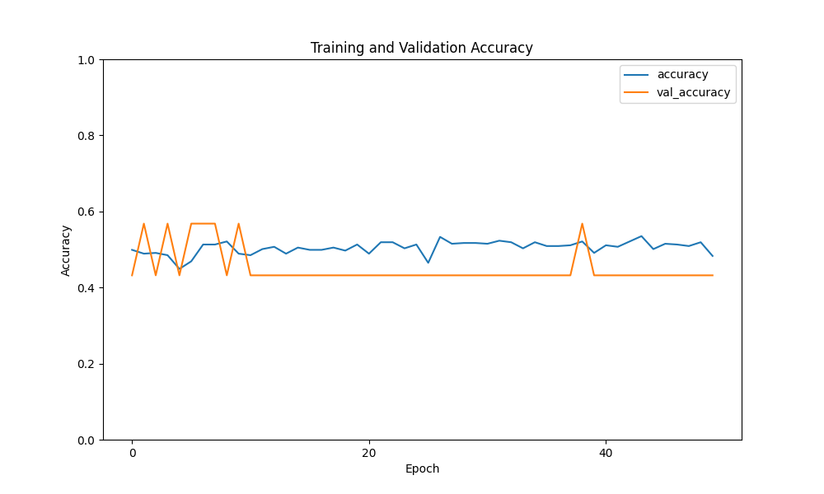
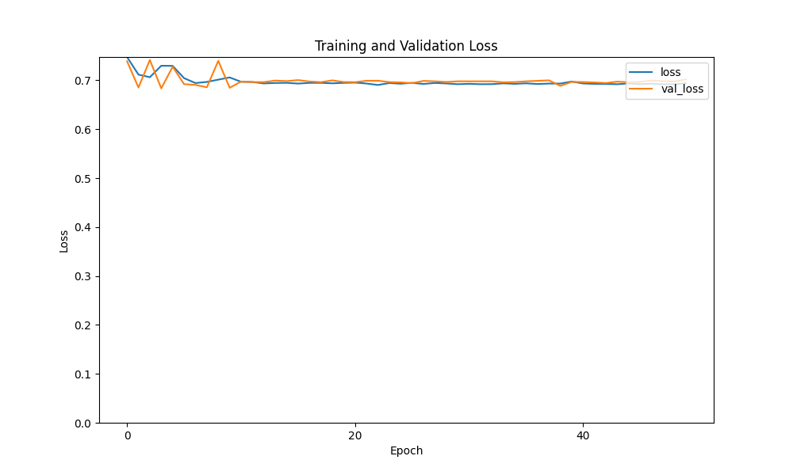
EfficientNet-SH-2Class-Female

Slide 46
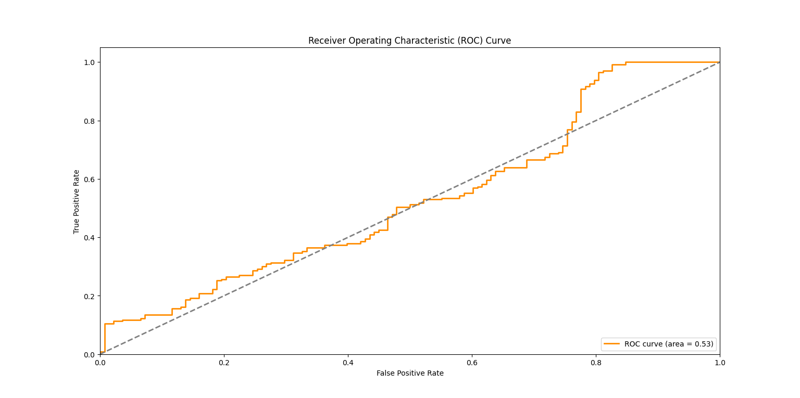
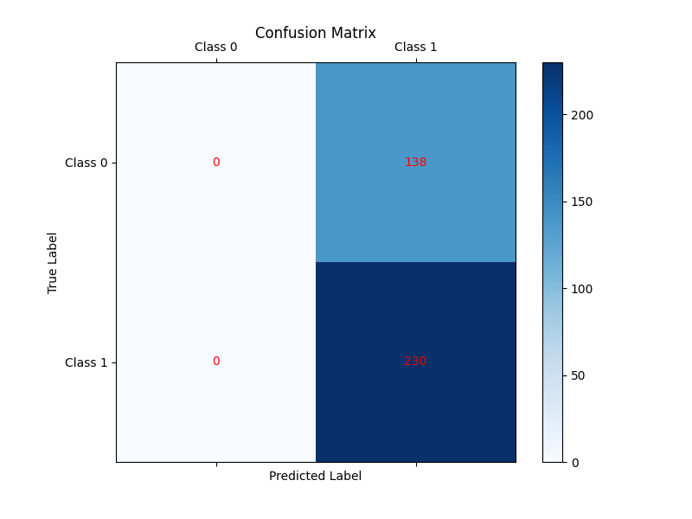
EfficientNet-SH-2Class-Female

Slide 47
VGG16-SH-2Class-Male

Slide 48
VGG16-SH-2Class-Male

Slide 49
VGG16-SH-2Class-Female

Slide 50
VGG16-SH-2Class-Female

Slide 51
VGG19-SH-2Class-Male

Slide 52
VGG19-SH-2Class-Male

Slide 53
VGG19-SH-2Class-Female

Slide 54
VGG19-SH-2Class-Female

Slide 55
0722

Slide 56
運行白平衡=>剪裁模型=>回歸分析
去除MobileNet的部分
記錄結果

Slide 57
只運行MobileNet
記錄結果

Slide 58
data={
白平衡模型名稱
眼瞼剪裁模型名稱
眼白剪裁模型名稱
貧血預測模型名稱
黃疸遇刺模型名稱
貧血數值
黃疸數值
有無貧血
}

Slide 59
data={
模型名稱
模型運行結果
}

Slide 60
0730

Slide 61
GoogLeNet-SH-2Class-Male

Slide 62
GoogLeNet-SH-2Class-Female

Slide 63
ResNet-SH-2Class-Male

Slide 64
ResNet-SH-2Class-Female

Slide 65
EfficientNet-SH-2Class-Male

Slide 66
EfficientNet-SH-2Class-Female

Slide 67
VGG16-SH-2Class-Male

Slide 68
VGG16-SH-2Class-Female

Slide 69
VGG19-SH-2Class-Male

Slide 70
VGG19-SH-2Class-Female

Slide 71
0806

Slide 72
PPG模型-SH-4Class

Slide 73
Data:2023/3~2024/5 訓練集:測試集=7:3

Slide 74
GoogLeNet-SH-4Class-Male

Slide 75
GoogLeNet-SH-4Class-Male

Slide 76
GoogLeNet-SH-4Class-Female

Slide 77
GoogLeNet-SH-4Class-Female

Slide 78
ResNet-SH-4Class-Male

Slide 79
ResNet-SH-4Class-Male

Slide 80
ResNet-SH-4Class-Female

Slide 81
ResNet-SH-4Class-Female

Slide 82
EfficientNet-SH-4Class-Male

Slide 83
EfficientNet-SH-4Class-Male

Slide 84
EfficientNet-SH-4Class-Female

Slide 85
EfficientNet-SH-4Class-Female

Slide 86
VGG16-SH-4Class-Male

Slide 87
VGG16-SH-4Class-Male

Slide 88
VGG16-SH-4Class-Female

Slide 89
VGG16-SH-4Class-Female

Slide 90
VGG19-SH-4Class-Male

Slide 91
VGG19-SH-4Class-Male

Slide 92
VGG19-SH-2Class-Female

Slide 93
VGG19-SH-2Class-Female

Slide 94
0813

Slide 95
PPG模型-4Class Train Data:SH 2023/3~2024/5 Test Data:HKM 2022/8~2022/12 1:90~140 2:140~200 3:200~400 0:<90,>400

Slide 96
GoogLeNet-SH-4Class-Male

Slide 97
GoogLeNet-SH-4Class-Female

Slide 98
ResNet-SH-4Class-Male

Slide 99
ResNet-SH-4Class-Female

Slide 100
VGG16-SH-4Class-Male

Slide 101
VGG16-SH-4Class-Female

Slide 102
VGG19-SH-4Class-Male

Slide 103
VGG19-SH-4Class-Female

Slide 104
0827

Slide 105
PPG模型-4Class Data:SH 2023/3~2024/8

Slide 106
GoogLeNet-SH-4Class-Male

Slide 107
GoogLeNet-SH-4Class-Male

Slide 108
GoogLeNet-SH-4Class-Female

Slide 109
GoogLeNet-SH-4Class-Female

Slide 110
ResNet-SH-4Class-Male

Slide 111
ResNet-SH-4Class-Male

Slide 112
ResNet-SH-4Class-Female

Slide 113
ResNet-SH-4Class-Female

Slide 114
VGG16-SH-4Class-Male

Slide 115
VGG16-SH-4Class-Male

Slide 116
VGG16-SH-4Class-Female

Slide 117
VGG16-SH-4Class-Female

Slide 118
VGG19-SH-4Class-Male

Slide 119
VGG19-SH-4Class-Male

Slide 120
VGG19-SH-4Class-Female

Slide 121
VGG19-SH-4Class-Female

